Slide 1
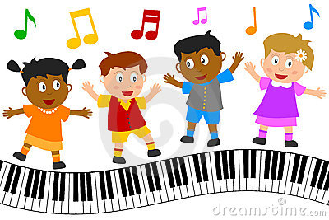
Let’s sing a song and dance

Slide 2
“Hello Song”

Slide 3
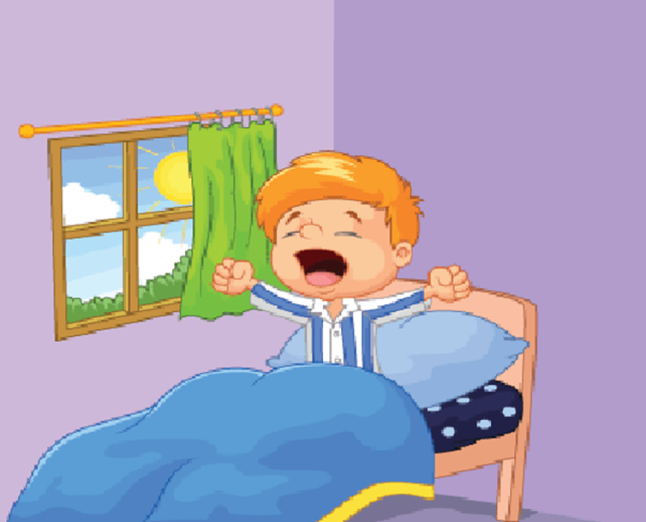
Unit 2: I always get up early. How about you?
Lesson 1: (1,2,3)

Slide 4
OBJECTIVES
Knowledge: students will be able to ask and answer questions about someone’s daily routine.
Skills: Listening – Speaking.
Vocabulary: always, usually, often, sometimes…
Grammar: What do you do…?
I always/ usually/ often….

Slide 5
New words

Slide 6
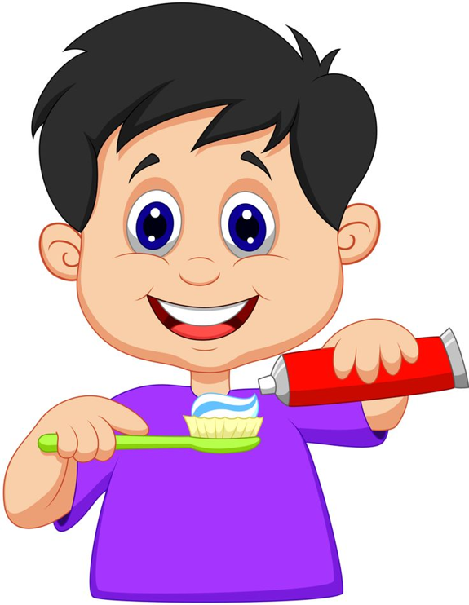
Brush teeth

Slide 7
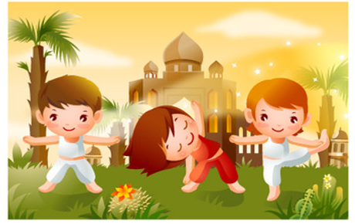
Do morning excercise

Slide 8
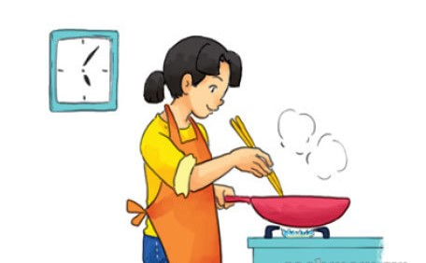
Cook dinner

Slide 9
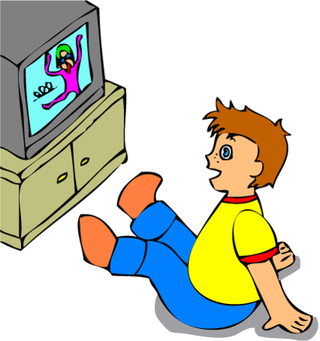
Watch TV

Slide 10
Get up

Slide 11
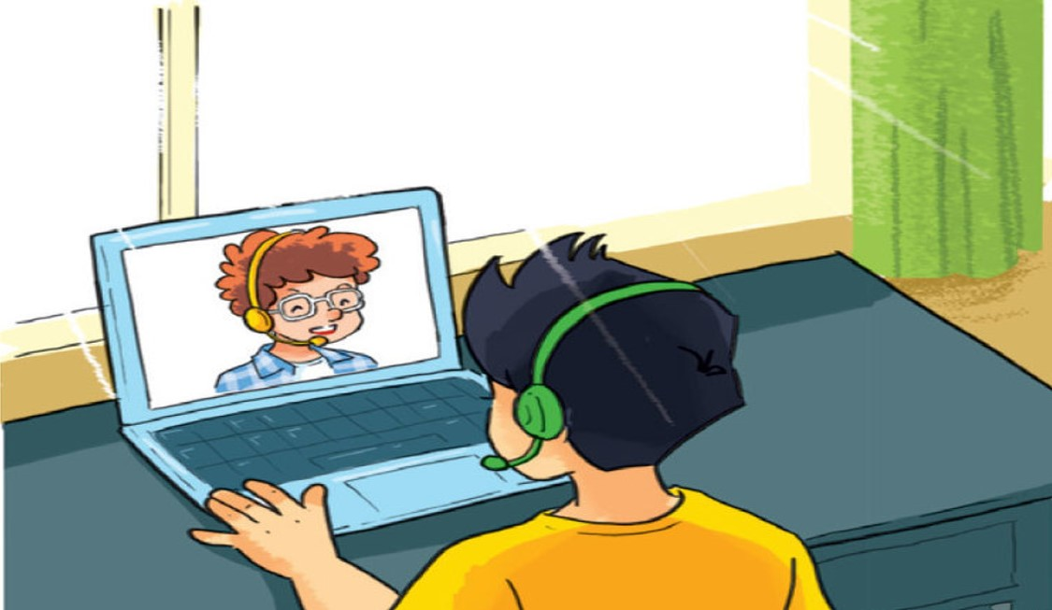
Talk with friends online

Slide 12
Let’s play
a matching game

Slide 13
Match the English words in column 1 with their meanings in column 2
Column 1
Column 2
D
1. Get up
A.
Xem tivi
C
2. Do morning excercise
B.
Nói chuyện trên mạng với bạn bè
A
3. Watch TV
C.
Tập thể dục buổi sáng
B
4. Talk with friends online
D.
Thức dậy
F
5. Cook dinner
E.
Đánh răng
E
6. Brush teeth
F.
Nấu bữa tối
Correct - Click anywhere or press Control Y to continue
Incorrect - Click anywhere or press Control Y to continue
You answered this correctly!
Submit
Clear
Your answer:
You must answer the question before continuing
You did not answer this question completely
The correct answer is:

Slide 14
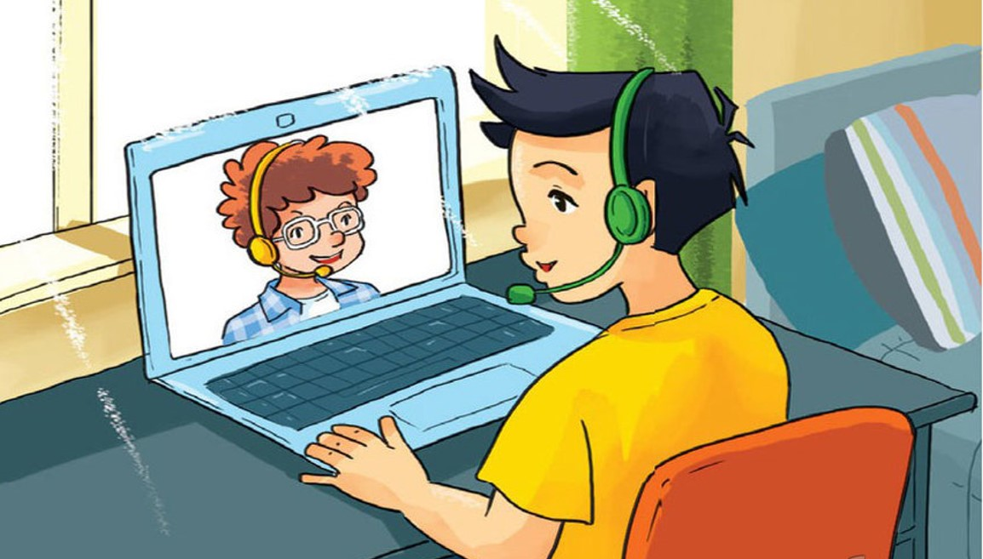
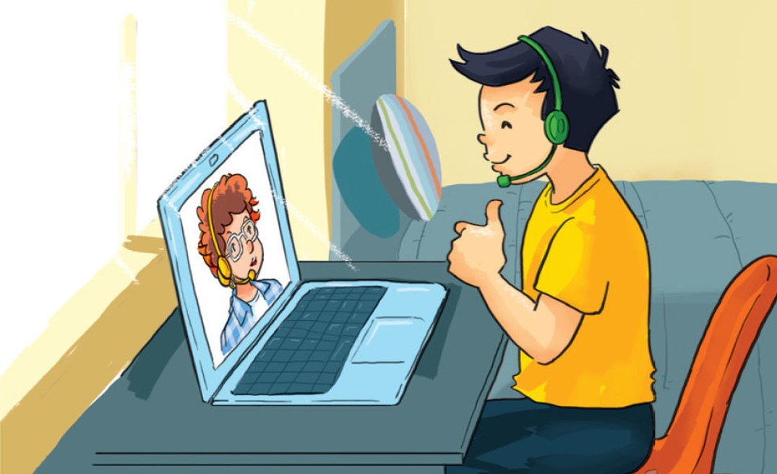
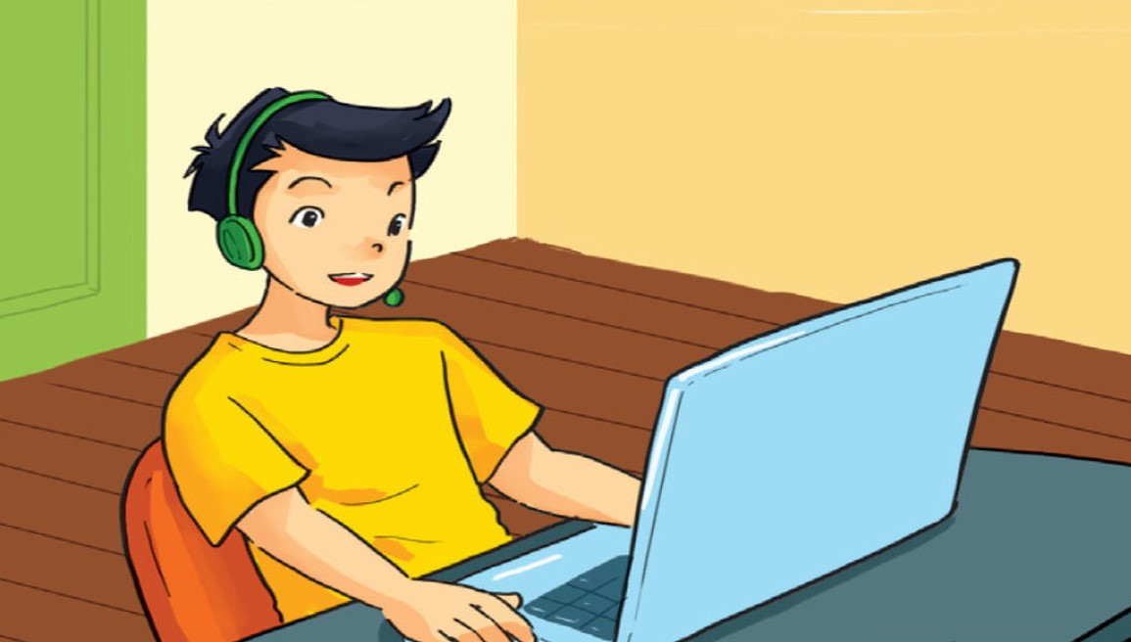
1. Look, listen and repeat

Slide 15
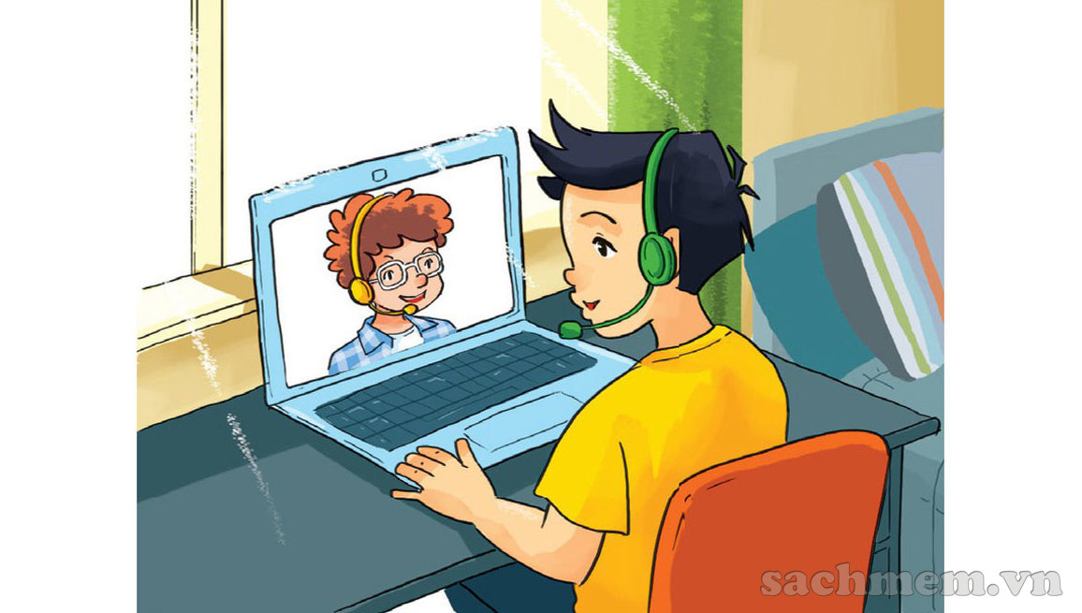

Hi, Quan! You’re up early.
Hi, Tom! Yes, I always get up early. How about you?

Slide 16
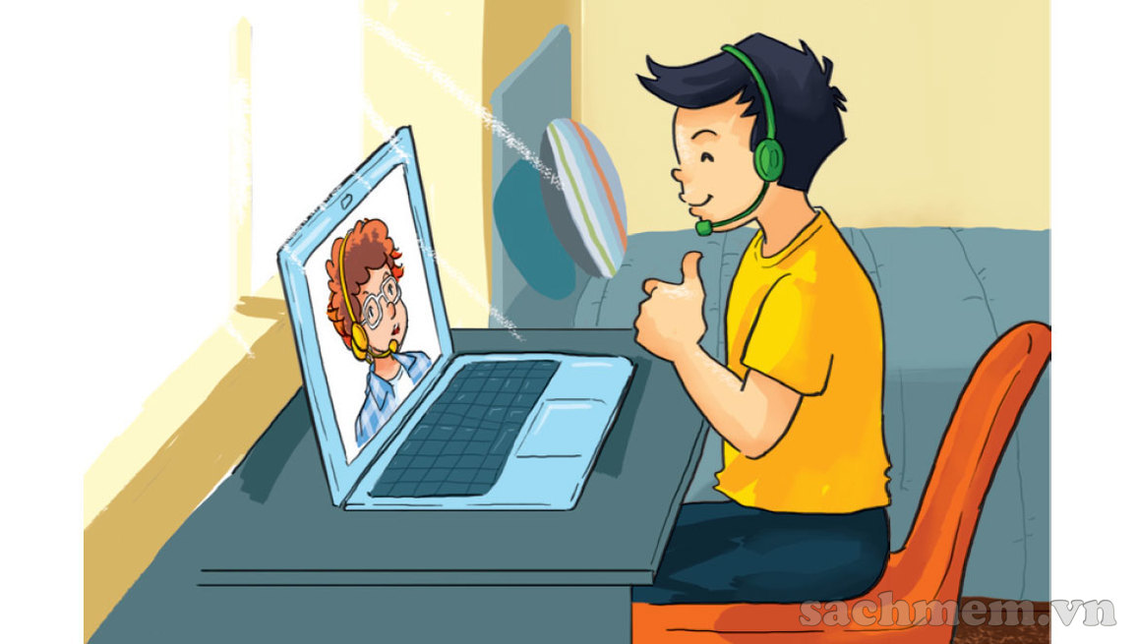
Me too. I get up early and I always have a big breakfast before I go to school.
Good idea!

Slide 17
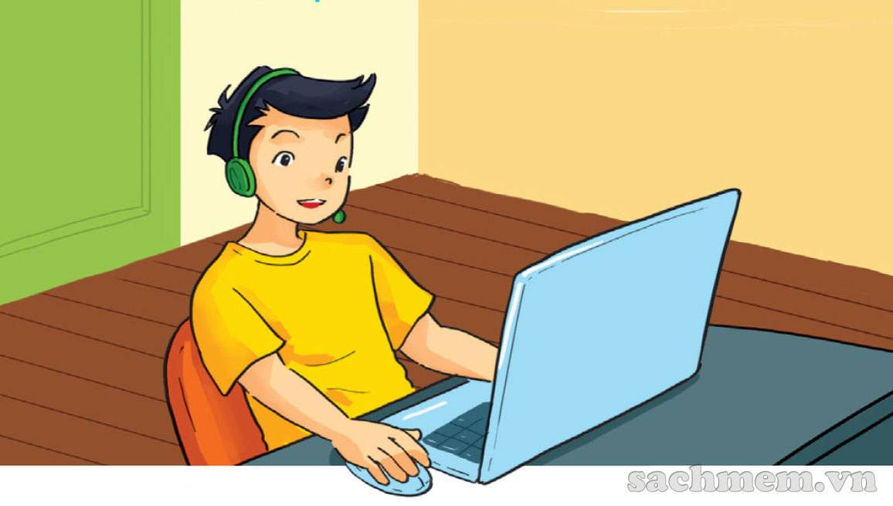
What do you do in the afternoon?
After school? I usually do my homework.

Slide 18
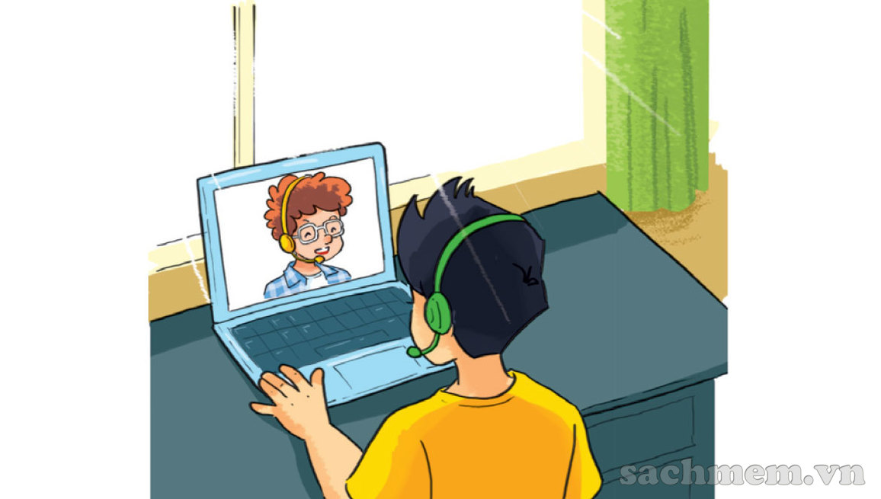
So do I. And I often talk with friends online.
I can see that, haha!

Slide 19
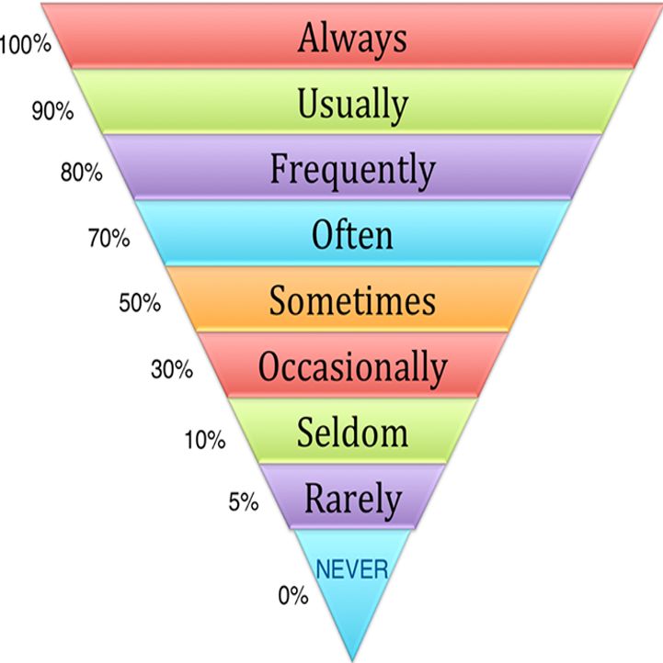
Adverbs of frequency
Luôn luôn
Thường xuyên
Thường xuyên
Thường xuyên
Thỉnh thoảng
Thi thoảng
Ít khi
Hiếm khi
Không bao giờ

Slide 20
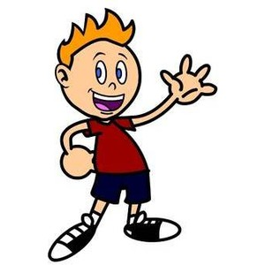
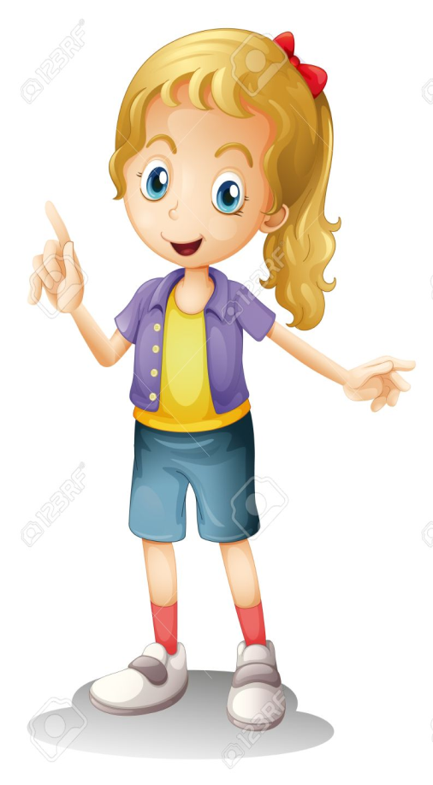
Grammar:
What do you do……….?
I always/ usually/ often/ sometimes......

Slide 21


Example 1:
What do you do in the morning?
I often read books.

Slide 22
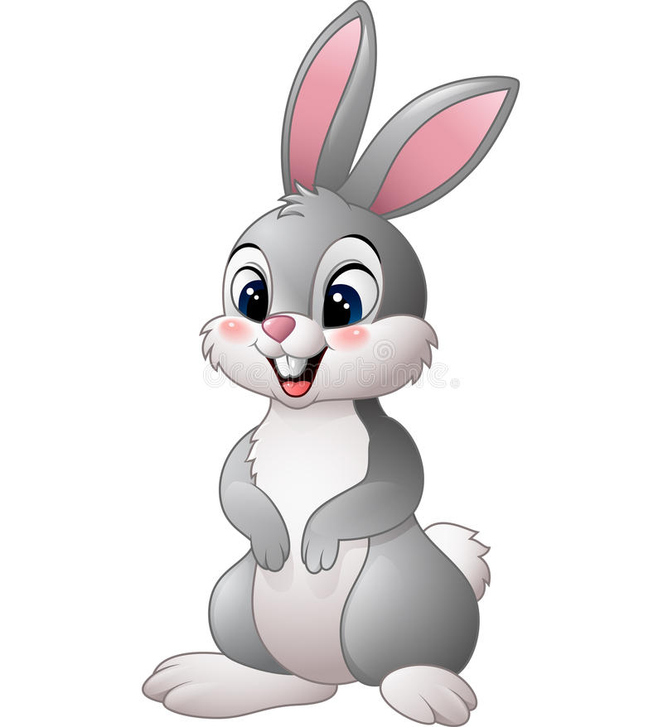
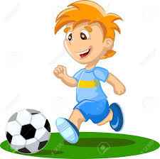
Example 2:
What do you do in the afternoon?
I usually play football.

Slide 23
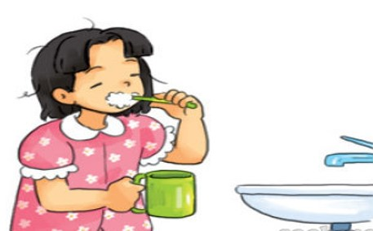
2. Point and say
morning/ always brush my teeth

Slide 24
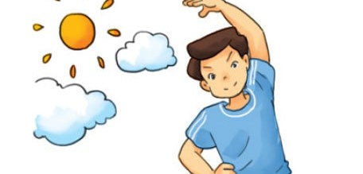
morning/ usually do morning exercise

Slide 25
afternoon/ often cook dinner

Slide 26
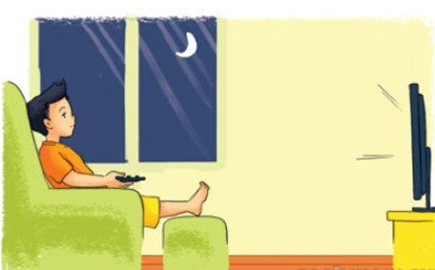
evening/ sometimes watch TV

Slide 27
Let’s talk
3
What do you do in the morning/ afternoon/ evening?
I always/ usually/ often/ sometimes……………

Slide 28
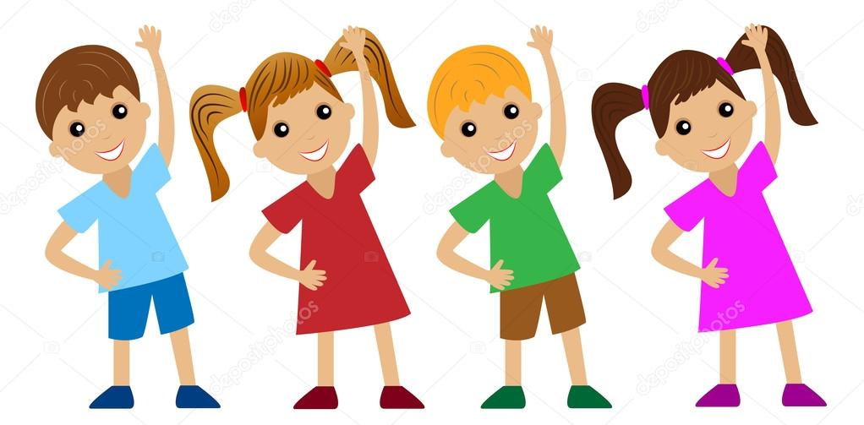
What do you do in the morning?
A)
I often do morning excercise.
B)
I often brush my teeth.
C)
I often cook dinner.
Correct - Click anywhere or press Control Y to continue
Incorrect - Click anywhere or press Control Y to continue
You answered this correctly!
Submit
Clear
Your answer:
You did not answer this question completely
You must answer the question before continuing
The correct answer is:

Slide 29
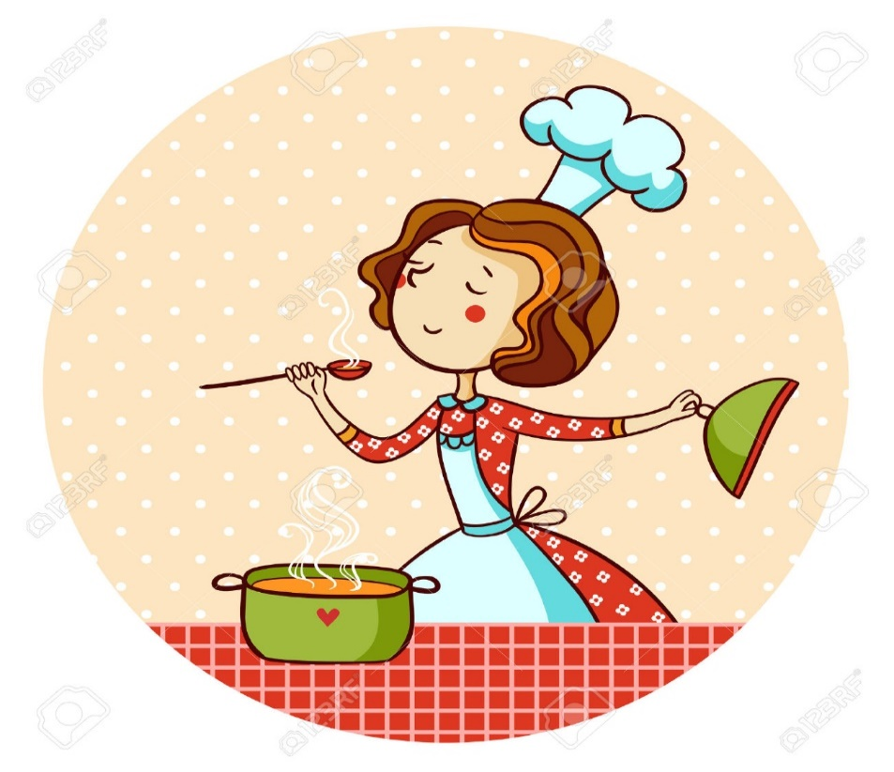
What do you do in the afternoon?
A)
I usually watch TV.
B)
I usually talk with friends online.
C)
I usually cook dinner.
Correct - Click anywhere or press Control Y to continue
Incorrect - Click anywhere or press Control Y to continue
Your answer:
You answered this correctly!
You did not answer this question completely
The correct answer is:
You must answer the question before continuing
Submit
Clear

Slide 30
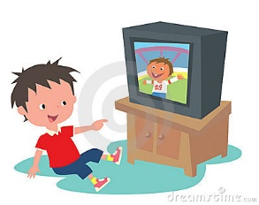
What do you do in the evening?
A)
I always brush my teeth.
B)
I always watch TV.
C)
I always talk with friends online.
Correct - Click anywhere or press Control Y to continue
Incorrect - Click anywhere or press Control Y to continue
Your answer:
You answered this correctly!
You did not answer this question completely
The correct answer is:
You must answer the question before continuing
Submit
Clear

Slide 31
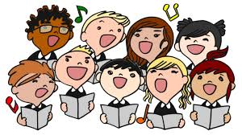
Let’s sing a song

Slide 32
Morning routines song

Slide 33


