Slide 1







g
o
a
t
r
o
o
d
e
n
f
n
o
Welcome to
our class

Slide 2
“Pass the box”
Game

Slide 3

UNIT 4: How old are you?
Lesson 3, part 1-2-3

Slide 4

f
five

Slide 5
f
five
I’m five years old

Slide 6
s
six

Slide 7
s
six
I’m six years old.

Slide 8
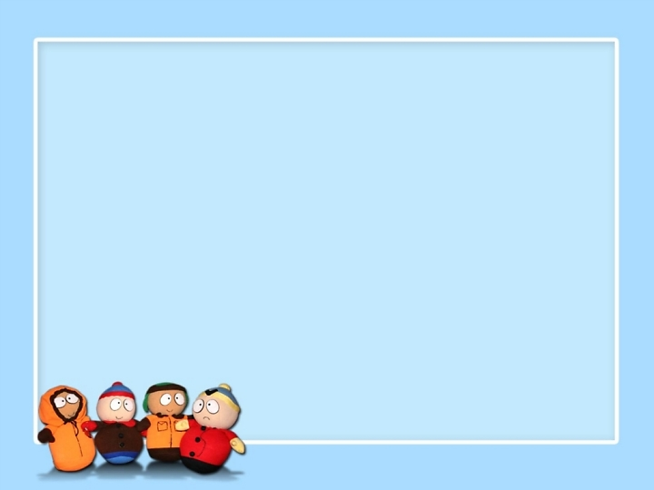
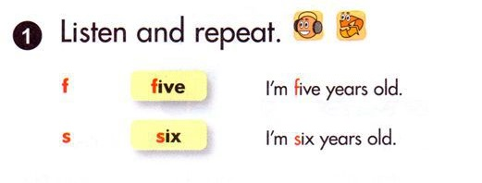


Slide 9
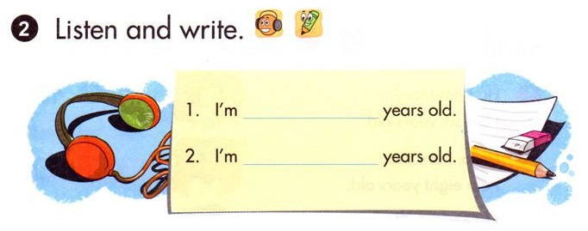
five
six

Slide 10
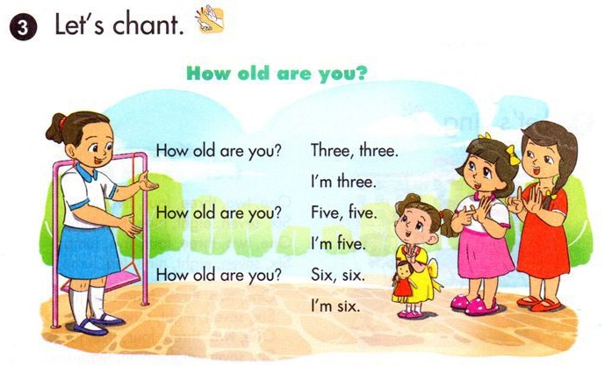

Slide 11

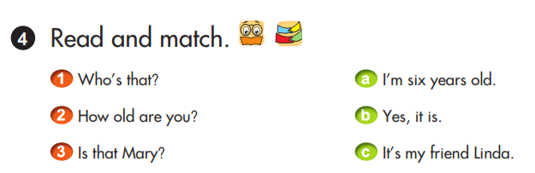

Slide 12
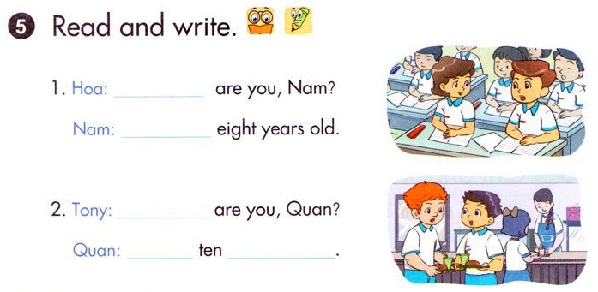
How old
I’m
How old
I’m
years old

Slide 13

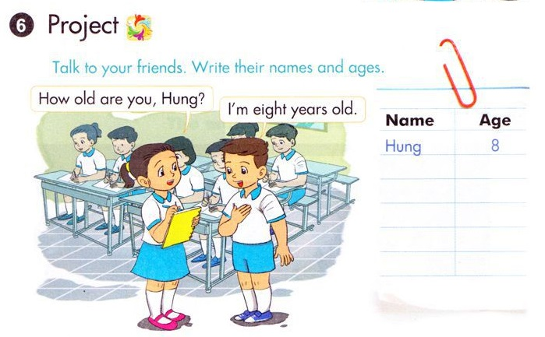

Slide 14




The bye bye song
Bye, bye.
See you tomorrow.
Bye, bye.
See you tomorrow.
Bye, bye.
See you tomorrow.
Bye, bye. Bye, bye.
The bye bye
song
Notes:
14
14

Slide 15


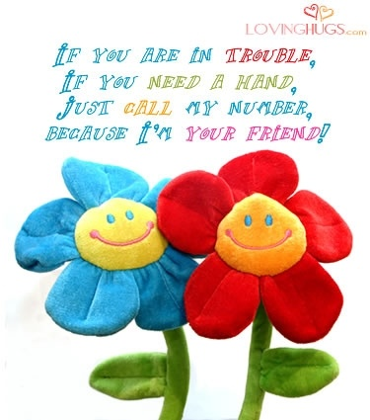
- Practise the chant at home.
- Prepare Unit 5 - Lesson1

Slide 16



Thank you very much
Good bye! See you again!

