Slide 1



Slide 2
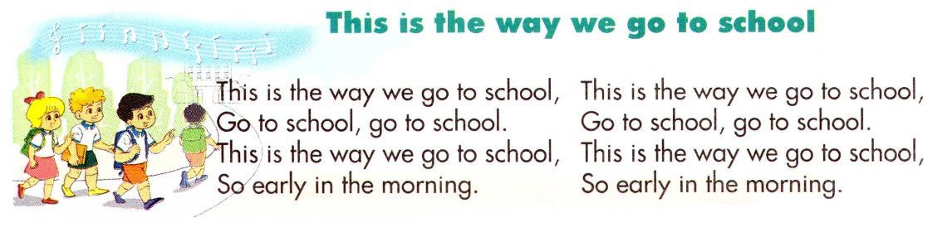

Warm up

Slide 3
Lucky number
1
2
3
4
5
6
7
8
9

Slide 4
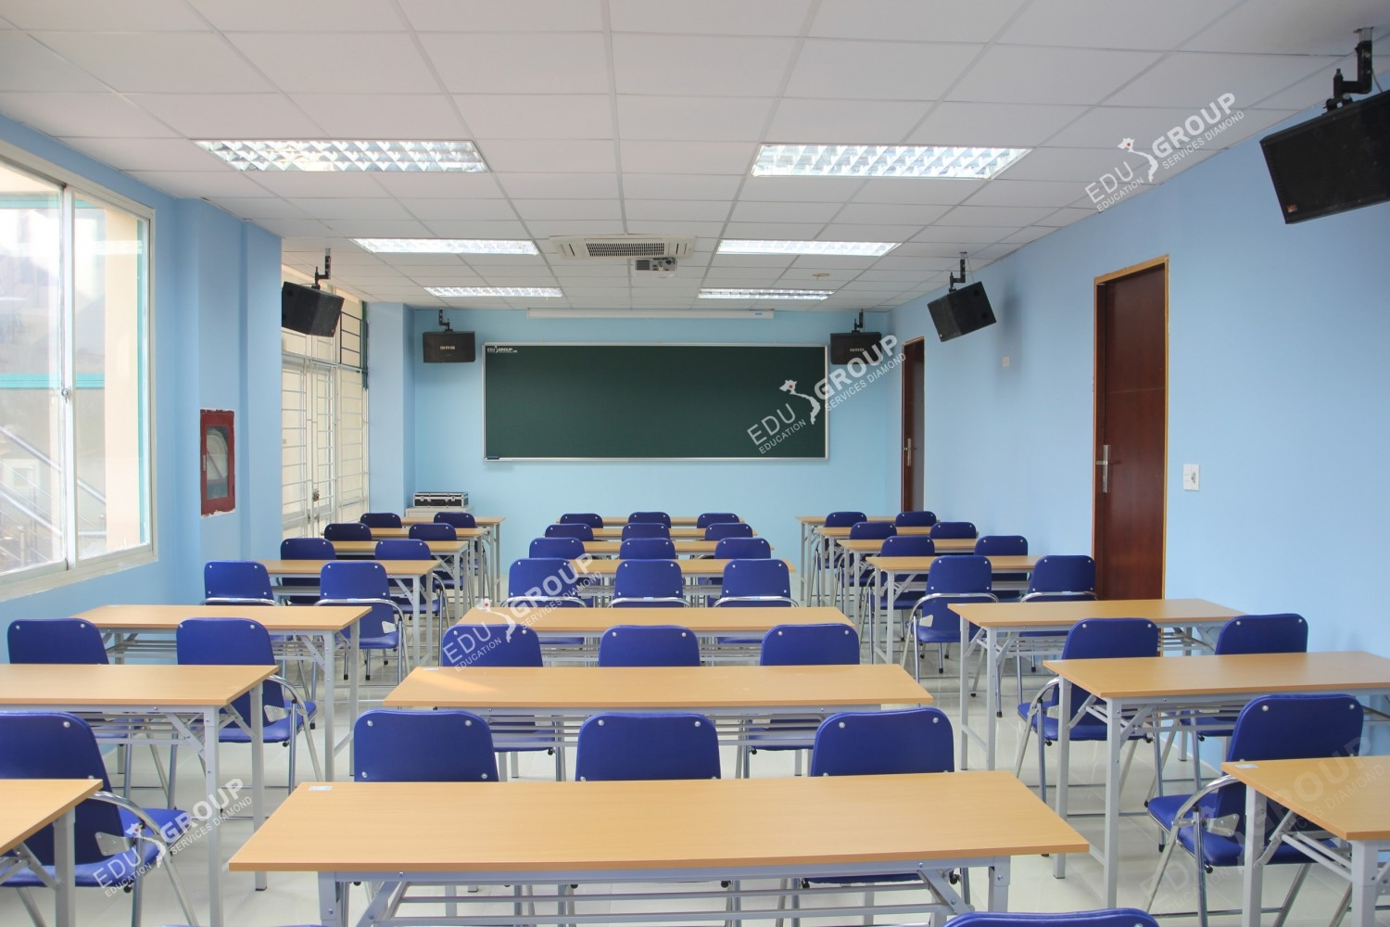
Number 1: What is this?
Classroom

Slide 5
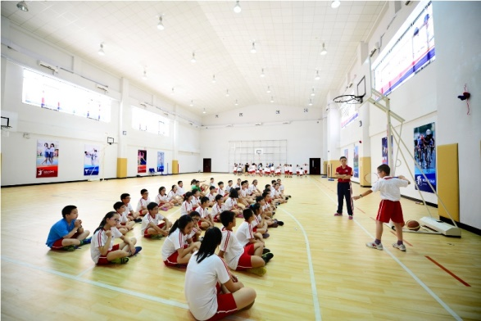
Number 2: What is this?
Gym

Slide 6
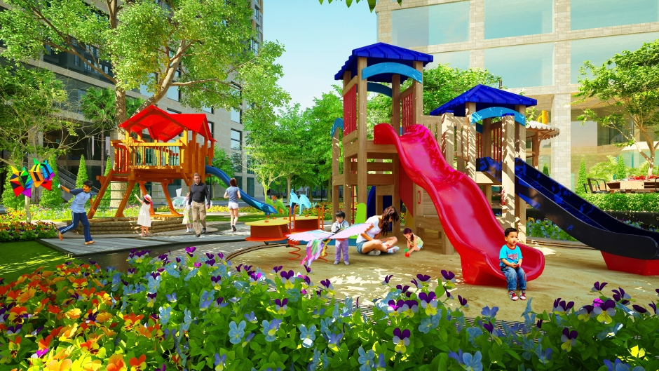
Number 3: What is this?
Playground

Slide 7

Number 4: What’s it like?
Big and small

Slide 8
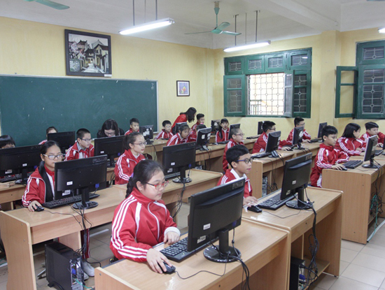
Number 5: What is this?
Computer room

Slide 9
Number 6
Lucky number

Slide 10
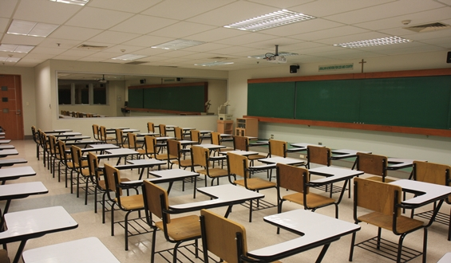
Number 7: What’s it like?
Large

Slide 11
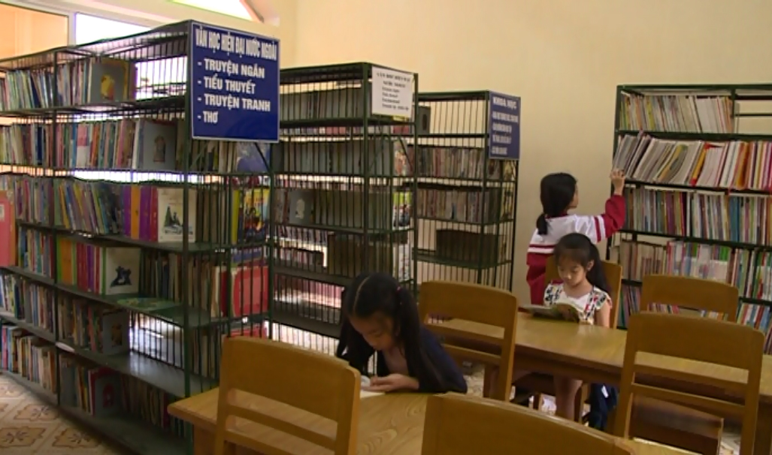
Number 8: What is this?
Library

Slide 12
Number 9
Lucky number

Slide 13

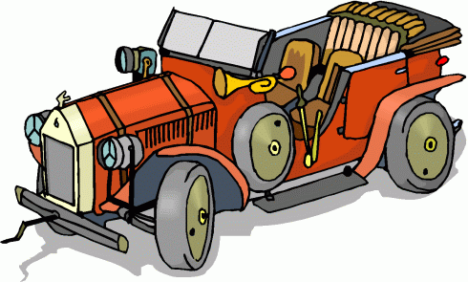
New words
New: Mới Old: Cũ

Slide 14
Matching
Classroom
Large
New
Old
Big
Small
Gym
Cũ
Mới
Nhỏ
Phòng học
Phòng tập thể thao
Rộng
Lớn

Slide 15

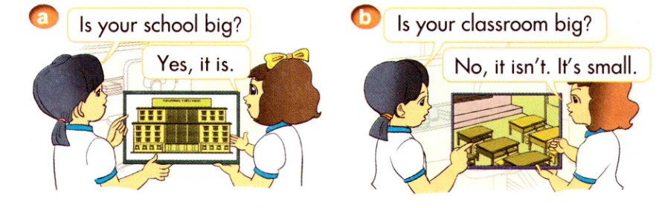
1. Look, listen and repeat

Slide 16

Model sentence
Is your school big?
Yes, it is.
No, it isn’t. It’s small.

Slide 17

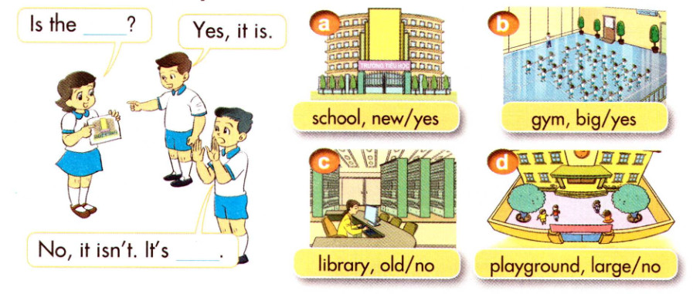
2. Point and say

Slide 18

LET’S SAY
A: Is the school new?
B: Yes, it is

Slide 19
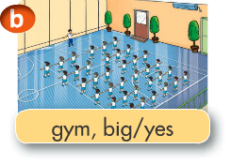
Let’s say
A: Is the gym big?
B: Yes, it is

Slide 20
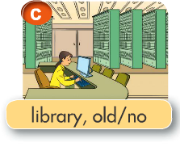
Let’s say
A: Is the library old?
B: No. It isn’t. It’s new.

Slide 21
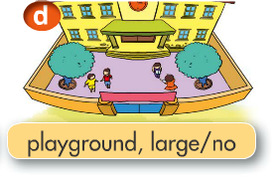
Let’s say
A: Is the playground large?
B: No. It isn’t. It’s small.

Slide 22
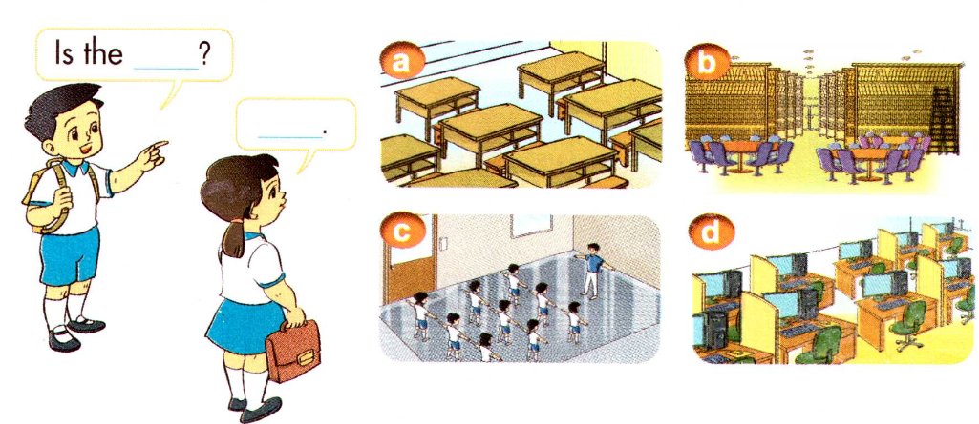
3. Let’s talk

Slide 23
Homework
Practice more
Learn vocabulary, model sentence by heart.
Prepare next lesson: Unit 7: Lesson 2: 4, 5,6.

Slide 24


