Slide 1


Dai Cuongprimary school
Welcome to our English lesson
Teacher: Phan Thi Lan Anh -Class 4c

Slide 2
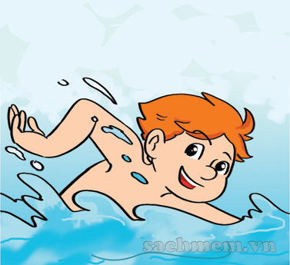
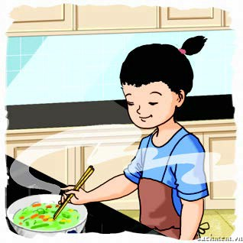
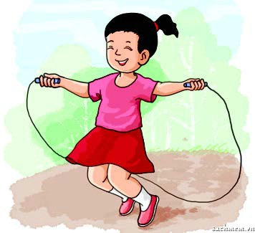
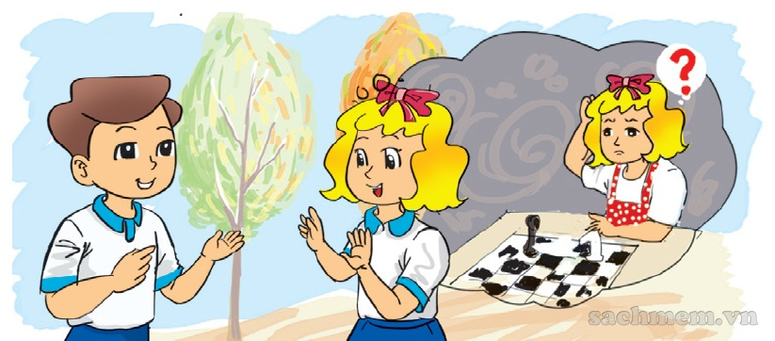
Wednesday, November 14th 2022
Board
Matching
1. She can skip.
a.
2. She can’t play chess.
b.
3. My sister can cook.
c.
4. Tony can swim.
d.

Slide 3

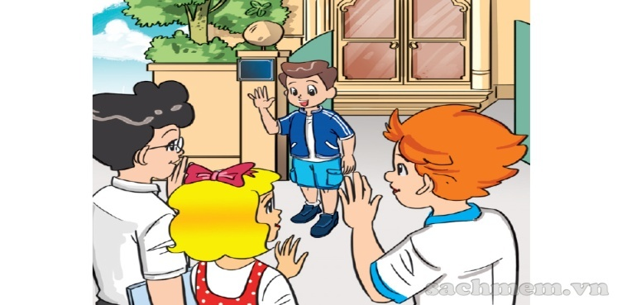
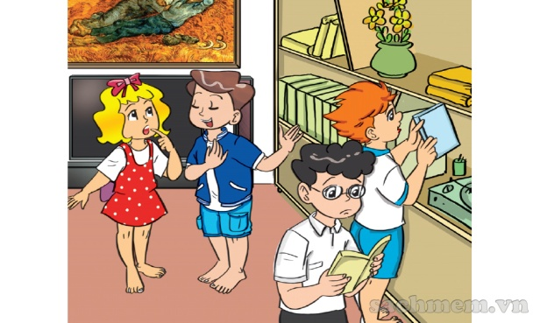
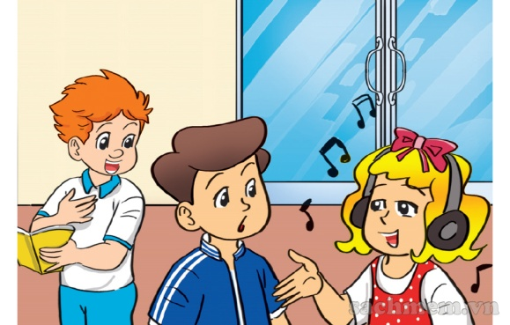
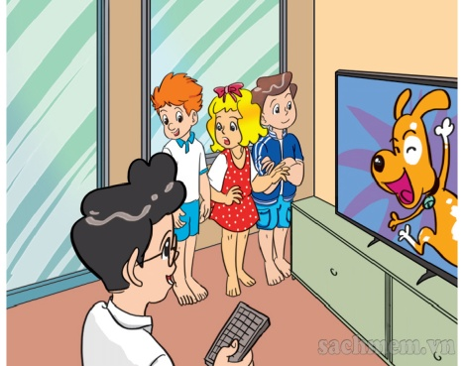
Wednesday, November 14th 2022
Unit 7: What do you like doing?
B.46
Lesson one- Part: 1-2- 3
1. Look, listen and repeat.
Wow! You have a lot of books!
Hello! Welcome to my house. Come in.
Yes, I like reading.
a.
Thank you.
b.
I like reading, too.
What do you like doing, Phong?
I don’t like reading.
I like listening to music.
d.
c.
I like watching TV.

Slide 4
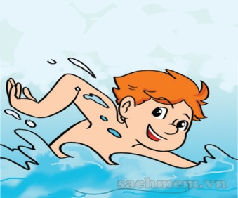
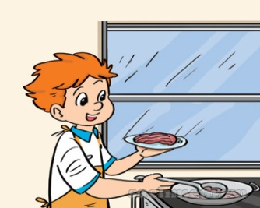
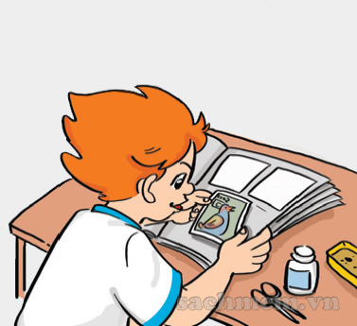
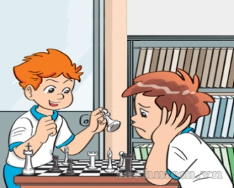
Wenesday, November 14th 2022
Unit 7: What do you like doing?
Lesson one- Part: 1-2-3
1. Look, listen and repeat.
2. Point and say.
* New words:
a.
collect stamps: sưu tầm tem
b.
c.
d.
swim
cook
collect stamps
play chess

Slide 5
Wesnesday, November 14th 2022
Unit 7: What do you like doing?
Lesson one- Part: 1-2-3
1. Look, listen and repeat.
2. Point and say.
* Model sentence:
Hỏi và trả lời ai thích làm việc gì đó.
What do you like doing?
I like …………............... .
* Note: like + to verb / verb -ing
a.
b.
c.
d.
swimming
playing chess
swim
cooking
cook
collect stamps
collecting stamps
play chess

Slide 6
Wednesday, November 14th 2022
Gr. 2
Unit 7: What do you like doing?
Lesson one- Part: 1-2-3
1. Look, listen and repeat.
2. Point and say.
What do you like doing?
I like …………............... .
a.
b.
c.
d.
swimming
cooking
collecting stamps
playing chess
swimming

Slide 7
Wednesday, November 14th 2022
Unit 7: What do you like doing?
Lesson one- Part: 1-2-3
Consolidation
* New words:
collect stamps: sưu tầm tem
* Sentence Patterm:
Hỏi và trả lời ai thích làm việc gì đó.
What do you like doing?
I like …………........ .
* Note: like + to verb / verb -ing

Slide 8

Goodbye. See you later!
Thank you very much!

