Slide 2
Wednesday, February 22nd , 2023
Unit 12 Don’t ride your bike too fast!
Lesson 2 - Part 1,2,3
Friday, February 10th, 2023

Slide 3
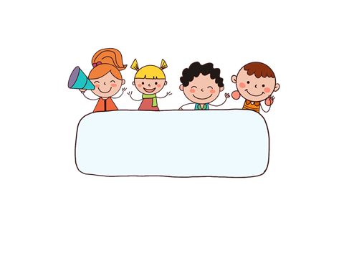
WARM UP

Slide 4
GAME: PASS THE BALL
Rules of the game:
* You listen to music and pass the ball to your friends.
* When the music stops, who has the ball standing to give the answer.

Slide 6
Don’t run down the stairs!

Slide 8
Don’t play with the knife !
You may.......................
cut yourself

Slide 10
Don’t play with the .................. You may get a burn.
matches!

Slide 12
Don’t ..........
Touch the stove !

Slide 13
WELL DONE!

