Slide 1
DAI LOC EDUCATION & TRAINING DEPARTMENT
Welcome to our class
Teacher: Phan Thi Lan Anh

Slide 2
Warm-up

Slide 3
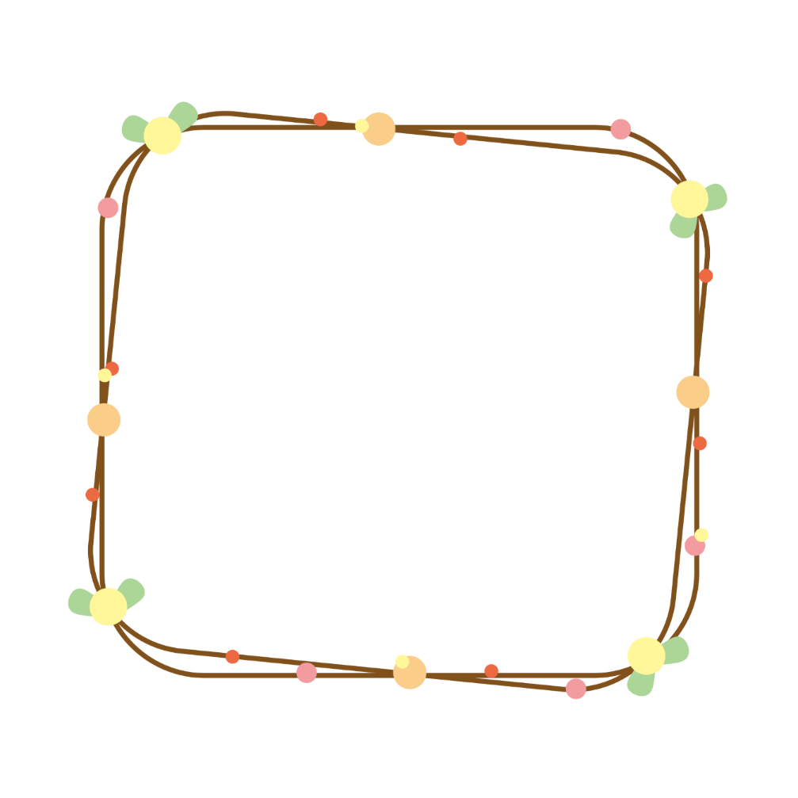
Let’s play!

Slide 4
The studious ants
PLAY

Slide 5
1
There are ___________.
two doors in the room
NEXT

Slide 6
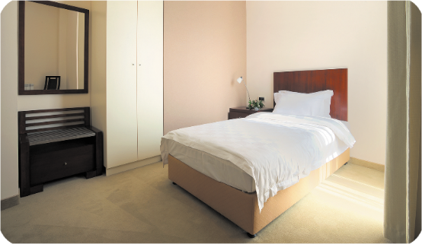
2
There’s ____________.
a bed
in the room
NEXT

Slide 7
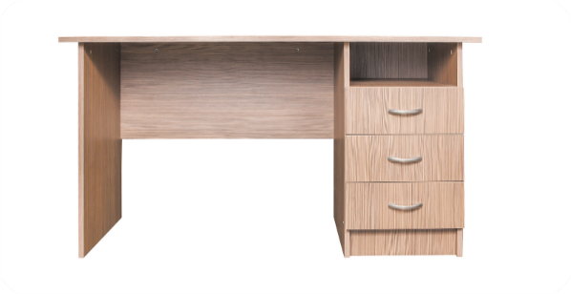
3
There’s __________.
a desk
in the room
NEXT

Slide 8
4
There ______________.
are two windows in the room
NEXT

Slide 9
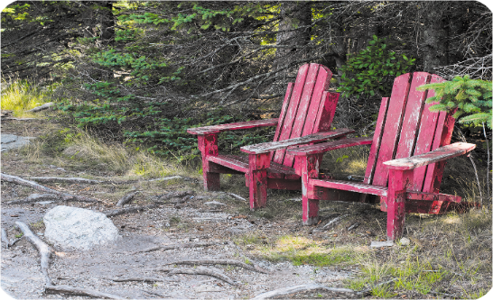
5
The chairs _________.
are old
NEXT

Slide 10
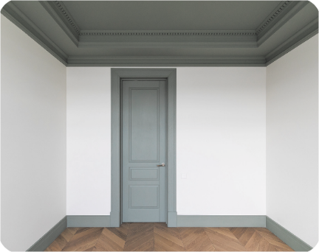
6
The _______________.
door is small
NEXT

Slide 11
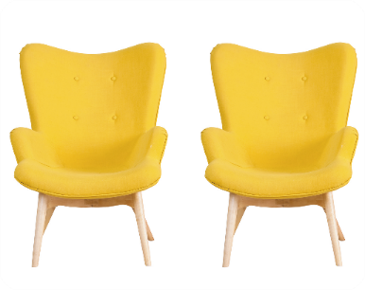
7
The ____________.
chairs are new
NEXT

Slide 12
WELL DONE!
END

Slide 13
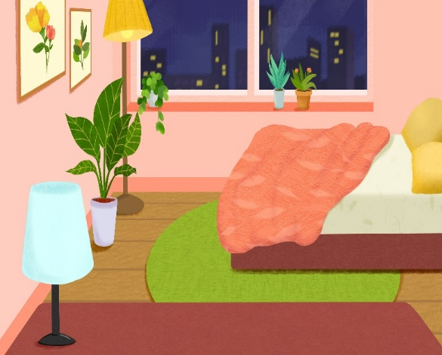
Friday, March 1st ,2024
My bedroom
Unit 14
Lesson 3 (4+5+6)

Slide 14
Contents
Read and complete.
Let’s write.
Project.

Slide 15
4. Read and complete.
desk
1
chairs
2
3
big
small
4

Slide 16
5. Let’s write.
This is my bedroom. It is _______________.
There is a ________________. It is _________________.
There are two _____________. They are ______________.
small
bed / desk
small / old
chairs
old / new

Slide 17
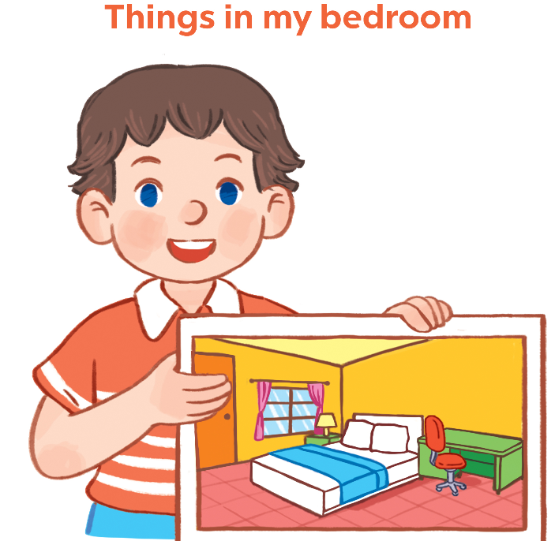
6. Project

Slide 18
Wrap up

Slide 19
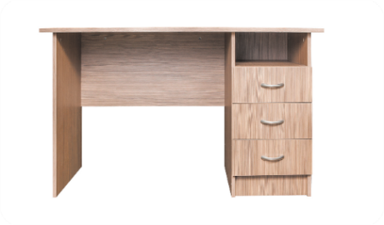
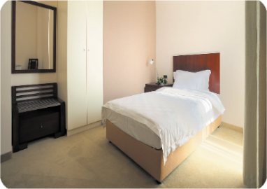
Unit 14 Lesson 1
There’s _____ in the room.
there’s = there is
There are _____ in the room.
a desk
two windows
a bed
two doors

Slide 20
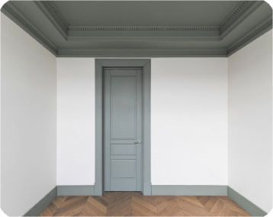
Unit 14 Lesson 2
The _____ is _________.
The ______ are ________.
door / big
chairs / old
door / small
chairs / new

Slide 23
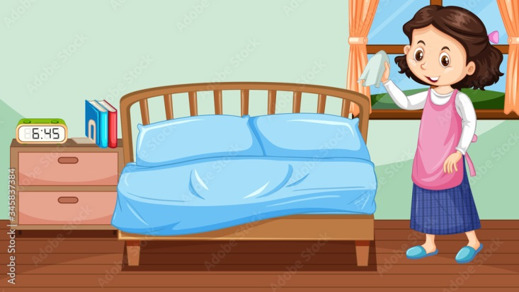

Slide 24
Homework
-Review the vocabulary and model sentences.
-Be ready for: Unit 15-Lesson1 –Activities 1,2,3

Slide 25
Thank you!

