Slide 2
Facebook : Bùi Liễu
0968142780
Monday, December 22th 2023
Jobs
Unit
12
Lesson 1 (1+2+3)

Slide 3
Warm-up

Slide 4
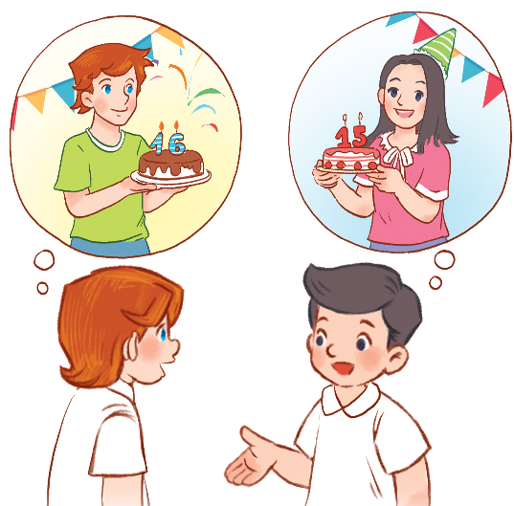
Let’s chant.
How old is your brother?
He’s sixteen.
He’s sixteen.
Are you sure?
Are you sure?
How old is your sister?
She’s fifteen.
She’s fifteen.
Are you sure?
Are you sure?
Ư

Slide 5
Contents
Look, listen and repeat.
Listen, point and say.
Let’s talk.

Slide 6
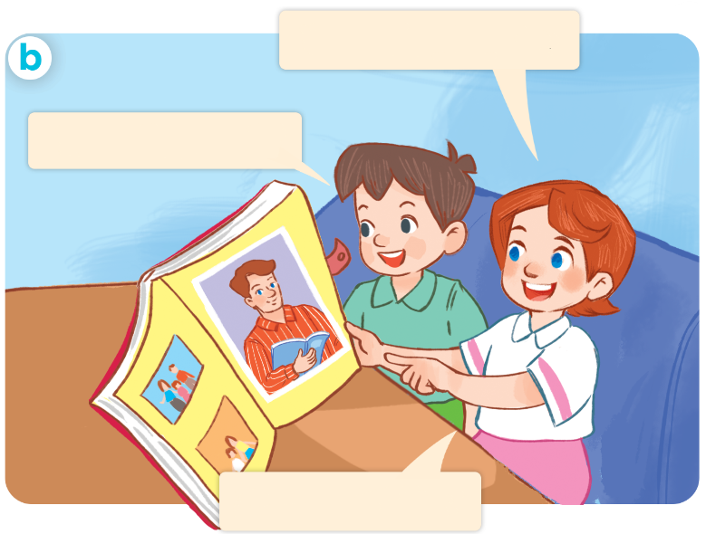
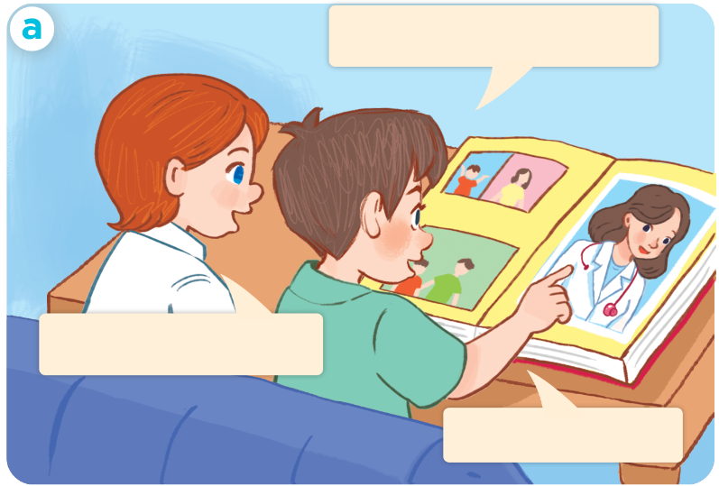
1. Look, listen and repeat.
This is my father.
This is my mother.
What’s his job?
What’s her job?
She’s a doctor.
He’s a teacher.
Who are they?
Where are they?
What are they doing?
Click on the speaker / sentences to listen.

Slide 7
Vocabulary

Slide 8
Vocabulary
jobs
/ʤɒbz/
các công việc
Click on the words to listen again.

Slide 9
Vocabulary
doctor
/ˈdɒktə/
bác sĩ

Slide 10
Vocabulary
driver
/ˈdraɪvə/
tài xế (lái xe)

Slide 11
Vocabulary
teacher
/ˈtiːʧə/
giáo viên

Slide 12
Vocabulary
worker
/ˈwɜːkə/
công nhân

Slide 13
Facebook : Bùi Liễu
Mobile phone: 0968142780
Review
jobs
doctor
driver
teacher
worker

Slide 14
Vocabulary
1. jobs
: các công việc
2. doctor
: bác sĩ
3. driver
: tài xế (lái xe)
4. teacher
: giáo viên
5. worker
: công nhân

Slide 15
Match
1
3
a. doctor
b. teacher
2
c. worker
4
d. driver

Slide 16
Structures

Slide 17
Structures
Hỏi và trả lời về công việc của ai đó.
- What’s his / her job?
He’s / She’s a _______.
(Công việc của anh ấy/ cô ấy là gì?)
he’s = he is
she’s = she is
(Anh ấy/ cô ấy là ______)
Example
Mary: What’s her job?
Linh: She’s a doctor.

Slide 18
Unit 12 lesson 1 (1+2+3)
he’s = he is
she’s = she is
What’s his / her job?
He’s / She’s______.
a doctor
a worker
a driver
a teacher

Slide 19
Facebook : Bùi Liễu
Mobile phone: 0968142780
2. Listen, point and say.
a
b
- What’s his / her job?
He’s / She’s _____.
a doctor
a driver
c
d
he’s = he is
she’s = she is
a teacher
a worker

Slide 20
2. Listen, point and say.
a
- What’s his / her job?
He’s / She’s _____.
a doctor
what’s her job?
She’s a doctor.
Click on the sentences to listen again.

Slide 21
2. Listen, point and say.
b
- What’s his / her job?
He’s / She’s _____.
a driver
What’s his job?
He’s a driver.

Slide 22
2. Listen, point and say.
c
- What’s his / her job?
He’s / She’s _____.
a teacher
what’s her job?
She’s a teacher.

Slide 23
2. Listen, point and say.
d
- What’s his / her job?
He’s / She’s _____.
a worker
what’s his job?
He’s a worker.

Slide 24
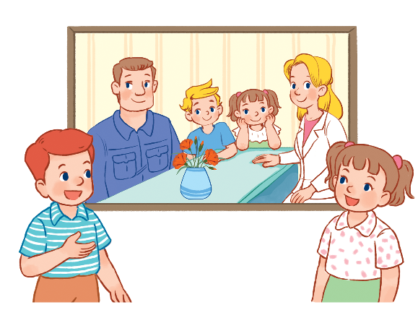
3. Let’s talk.
What’s his / her job?
He’s / She’s _____.

Slide 25
Ms Huyền Phạm
0936.082.789

Slide 26
A. teacher
B. worker
Ms Huyền Phạm
0936.082.789

Slide 27
A. worker
B. doctor
Ms Huyền Phạm
0936.082.789

Slide 28
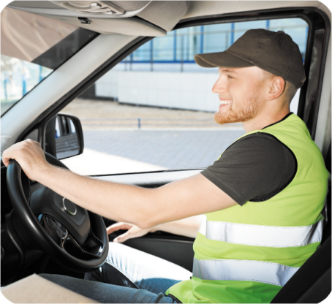
A. teacher
B. driver
Ms Huyền Phạm
0936.082.789

Slide 29
A. worker
B. doctor
Ms Huyền Phạm
0936.082.789

Slide 30
What’s his ______?
He’s a worker.
A. name
B. job
Ms Huyền Phạm
0936.082.789

Slide 31
What’s ______ job?
He’s a doctor.
A. her
B. his
Ms Huyền Phạm
0936.082.789

Slide 32
What is _____ job?
She is doctor.
A. her
B. his
Ms Huyền Phạm
0936.082.789

Slide 33
What’s his job?
______ a driver.
A. She’s
B. He’s
Ms Huyền Phạm
0936.082.789

Slide 34
What’s her job?
______ a teacher.
A. She’s
B. She
Ms Huyền Phạm
0936.082.789

Slide 35
______ her job?
A. What is
B. What
Ms Huyền Phạm
0936.082.789

Slide 36
Good job!
Ms Huyền Phạm
0936.082.789

Slide 37
Wrap up

Slide 38
Review
he’s = he is
she’s = she is
What’s his / her job?
He’s / She’s______.
a doctor
a worker
a driver
a teacher

Slide 39
Homework
Learn by heart all the new words.
Read again the dialogue in part 1.

Slide 40
Facebook: Bùi Liễu
0968142780
Thank you!

