Slide 1
Friday, December 15th 2023
Colours
Unit
9
Lesson 3
Facebook : Bùi Liễu
0968142780
Notes:
Facebook : Bùi Liễu
Mobile phone: 0968142780

Slide 2


Let’s play!

Slide 3
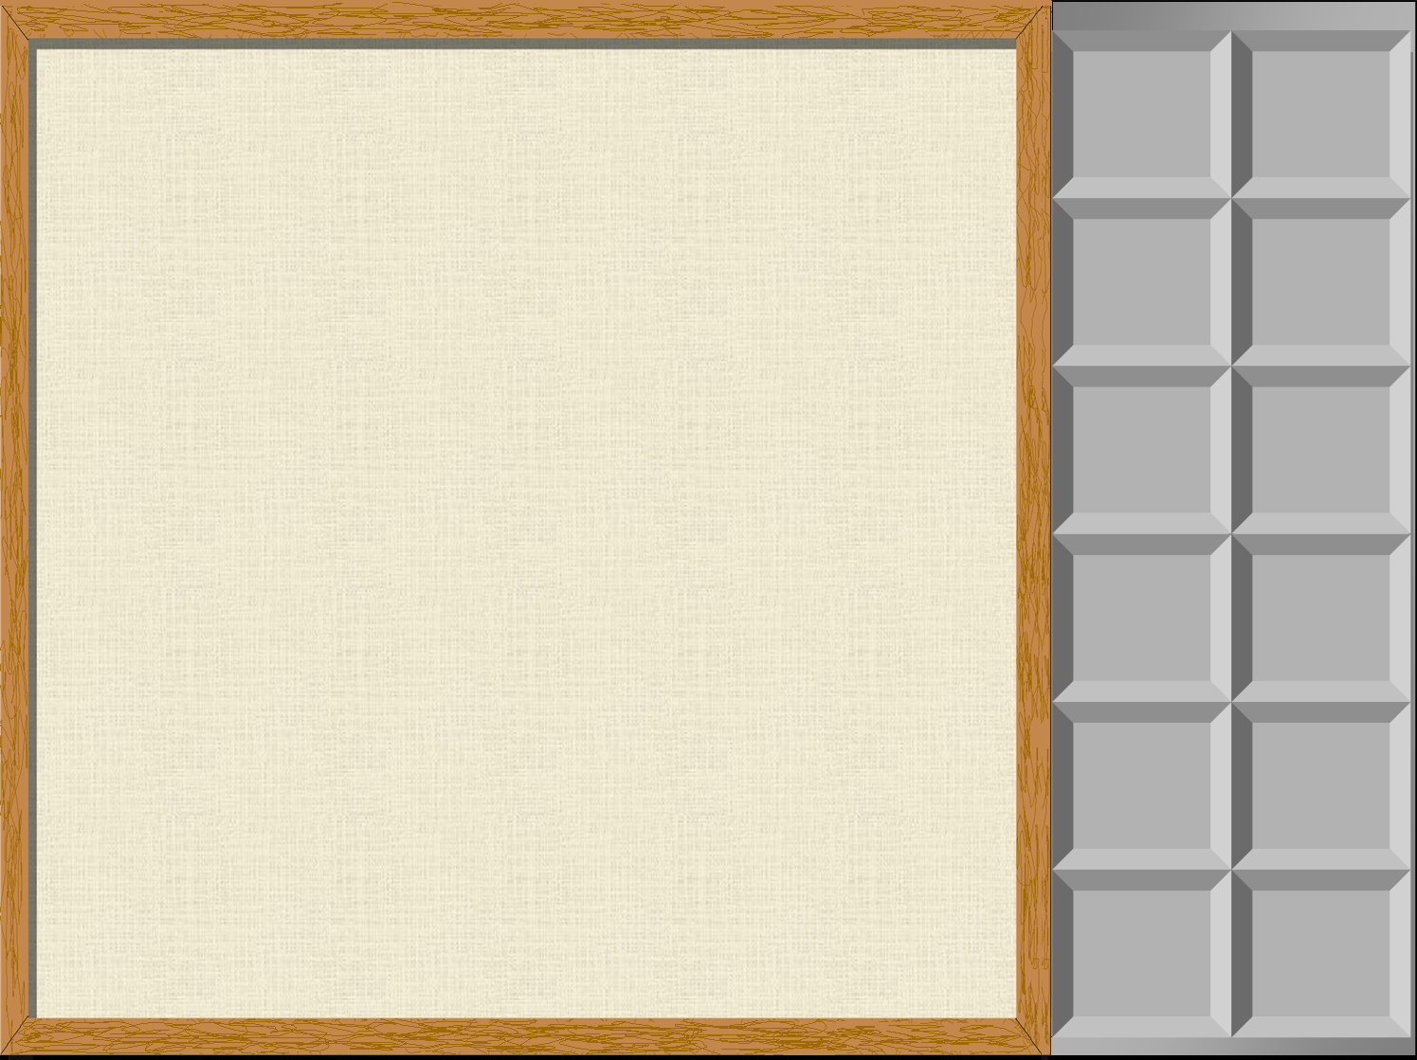
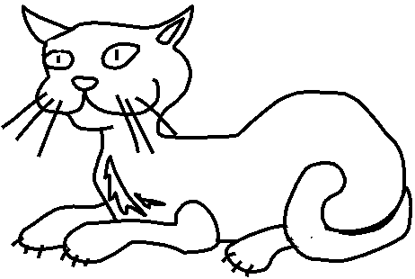


What color is it?
It is ...

Slide 4
What color is it?
It is ...

Slide 5


What color is it?
It is ...

Slide 6


What color is it?
It is ...

Slide 7


What color is it?
It is ...
A. blue
B. green
C. brown
D. black

Slide 8

What color is it?
It is ...
A. blue
B. green
C. brown
D. black

Slide 9


What color are they?
They’re...
A. white
B. yellow
C. orange
D. red

Slide 10


What color is it?
It is ...
A. white
B. yellow
C. orange
D. red

Slide 11


What color is it?
It is ...
A. orange
B. pink
C. blue
D. black

Slide 12


What color are they?
They’re...
A. white
B. yellow
C. brown
D. black

Slide 13
Well done!

Slide 14
Contents
1
Listen and repeat.
2
Listen and circle.
3
Let’s chant.
4
Read and tick.
5
Let’s write.
6
Project.

Slide 15
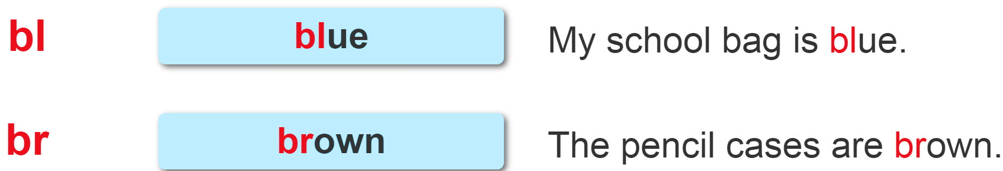

1. Listen and repeat.
Notes:
Facebook : Bùi Liễu
Mobile phone: 0968142780

Slide 16
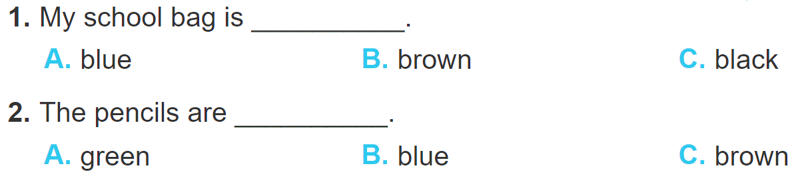
2. Listen and circle.
Facebook : Bùi Liễu
0968142780
Notes:
Facebook : Bùi Liễu
Mobile phone: 0968142780

Slide 17
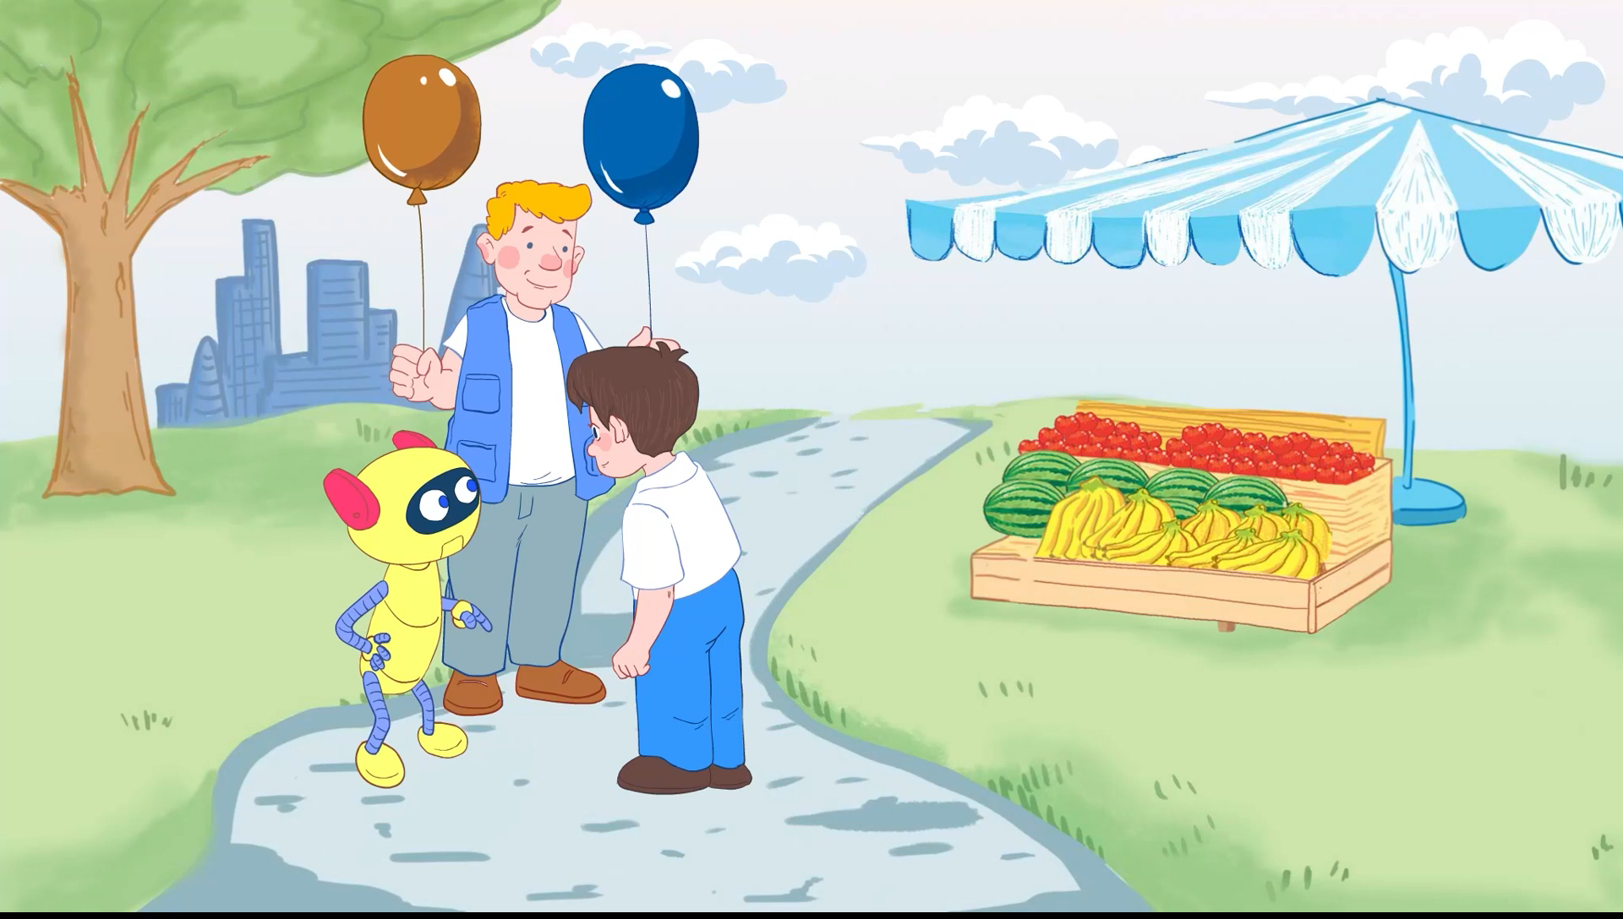
3. Let’s chant.
Notes:
Facebook : Bùi Liễu
Mobile phone: 0968142780

Slide 18
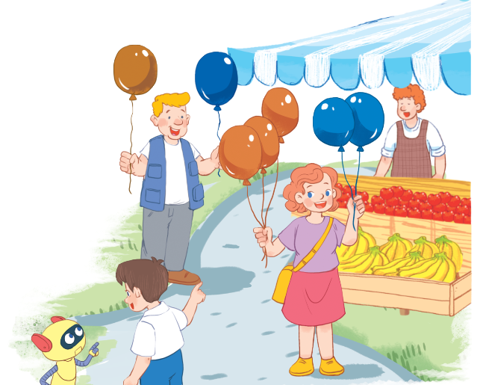
3. Let’s chant.
What colour is it?
Facebook : Bùi Liễu
0968142780
It’s blue.
What colour is it?
It’s brown.
What colour are they?
They’re blue.
What colour are they?
They’re brown.
Notes:
Facebook : Bùi Liễu
Mobile phone: 0968142780

Slide 19

4. Read and tick.
Look at my school things. I have a school bag. It’s brown. My books
and notebooks are blue. My pencil case and eraser are orange. My
pen and pencil are black. I like my school things very much.
My school things | black | blue | brown | orange
1. school bag
2. books and notebooks
3. pencil case and eraser
4. pen and pencil

Slide 20


START

Slide 21





What colour is it?
It’s blue.
Check
Next

Slide 22

What colour is it?
It’s yellow.
Check
Next

Slide 23
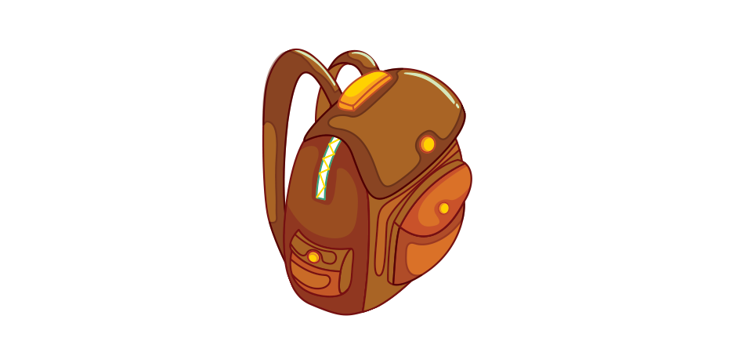
What colour is it?
It’s brown.
Check
Next

Slide 24
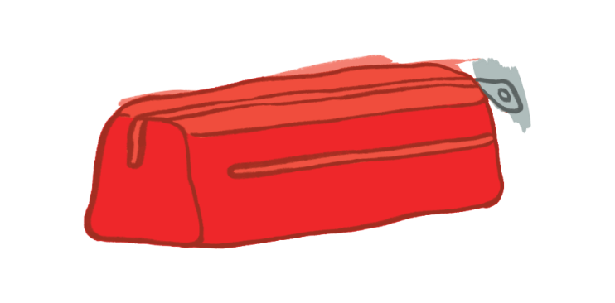
What colour is it?
It’s red.
Check
Next

Slide 25

What colour are they?
They’re orange.
Check
Next

Slide 26
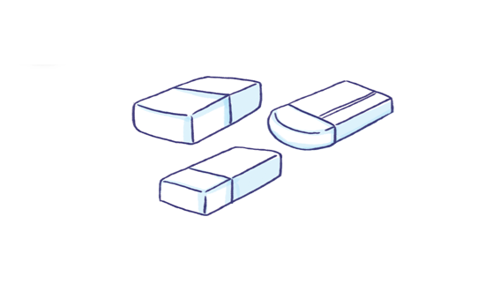
What colour are they?
They’re white.
Check
Next

Slide 27
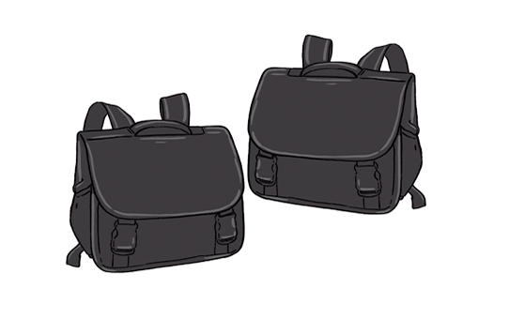
What colour are they?
They’re black.
Check
Next

Slide 28

What colour are they?
They’re green.
Check
Next

Slide 29
Good job!
End

Slide 30
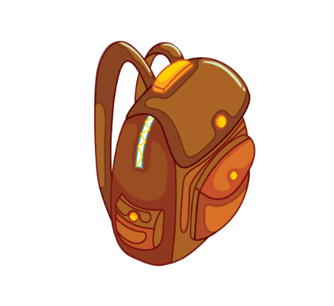



5. Let’s write
I have a school bag. It is brown. I have a pen. It is ____.
I have two _______. They are ____.
red
erasers
blue

Slide 31
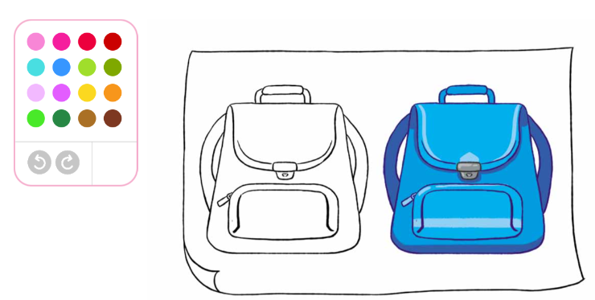
6. Project
Colours of my school things.

Slide 32





Vocabulary
colour
blue
brown
red
yellow
Notes:
Facebook : Bùi Liễu
Mobile phone: 0968142780

Slide 33
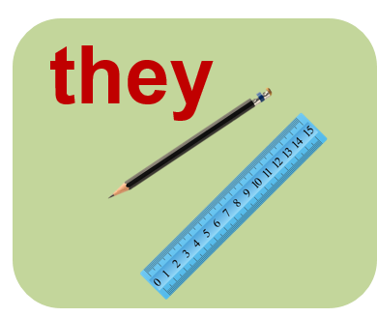




Vocabulary
they
orange
green
white
black
Notes:
Facebook : Bùi Liễu
Mobile phone: 0968142780

Slide 34
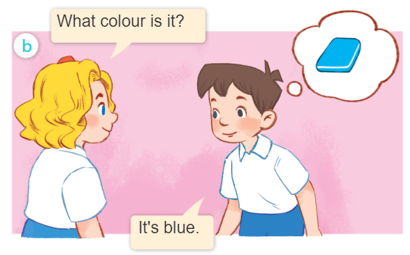
Structures
Khi muốn hỏi màu sắc của một đồ vật, ta sử dụng mẫu câu.
What colour is it?
- It’s _________.
(Nó có màu gì vậy?)
(Nó màu ______.)
Example:

Slide 35
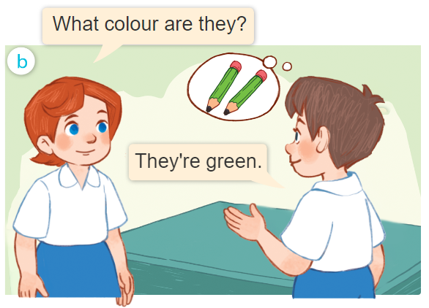
Structures
Khi muốn hỏi màu sắc của 2 đồ vật trở lên, ta sử dụng mẫu câu.
What colour are they?
- It’s _________.
(Chúng có màu gì vậy?)
(Chúng màu ______.)
Example:

Slide 36
Homework
Learn by heart all the new words.
.......................

Slide 37
Facebook : Bùi Liễu
0968142780
Thank you!
Notes:
Facebook : Bùi Liễu
0968142780

