Slide 1
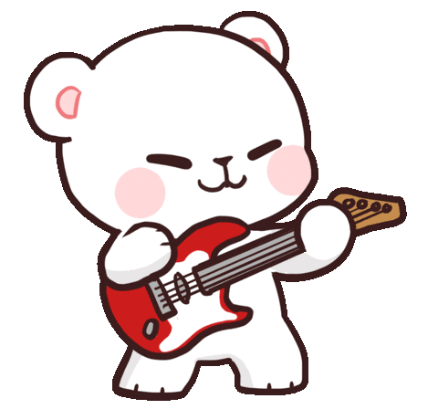
Welcome to our class!

Slide 2
Warm-up
& review

Slide 3
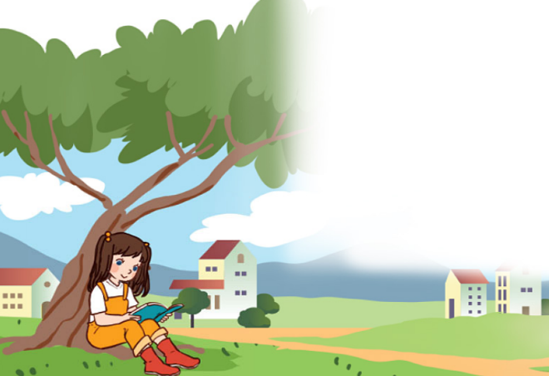
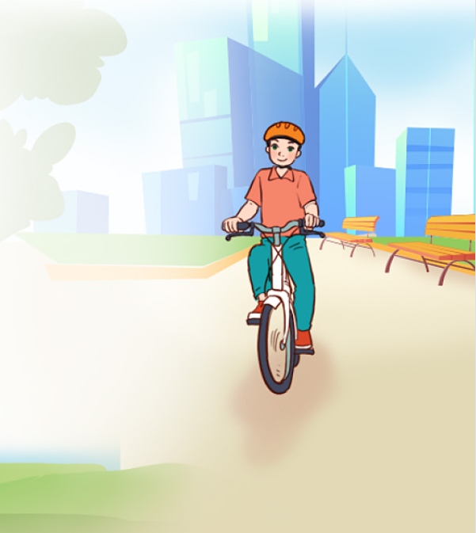
Let’s sing.
All about me!
I’m Lisa.
I’m Alan.
I’m in Grade 3.
I’m in Grade 5.
I live in the countryside.
I live in the city.
Where do you live?
Where do you live?
Nhấn vào loa để chạy chữ và nghe toàn bài.

Slide 4
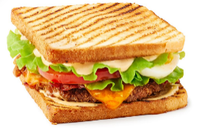
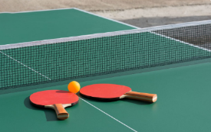
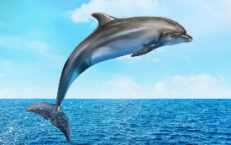
Monday, May 20th 2024
Unit 1
All about me!
Lesson 2

Slide 5
Contents
Look, listen and repeat.
Listen, point and say.
Let’s talk.
Listen and match.
Read and complete.
Let’s play.

Slide 6
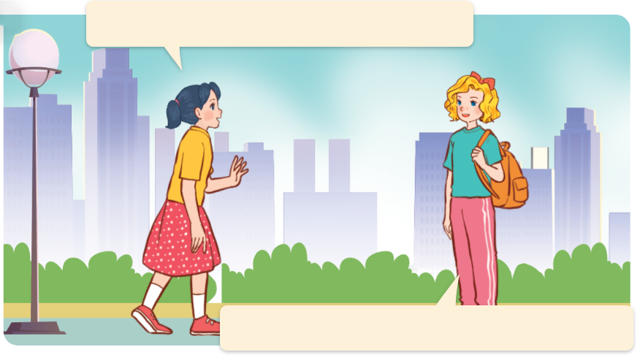
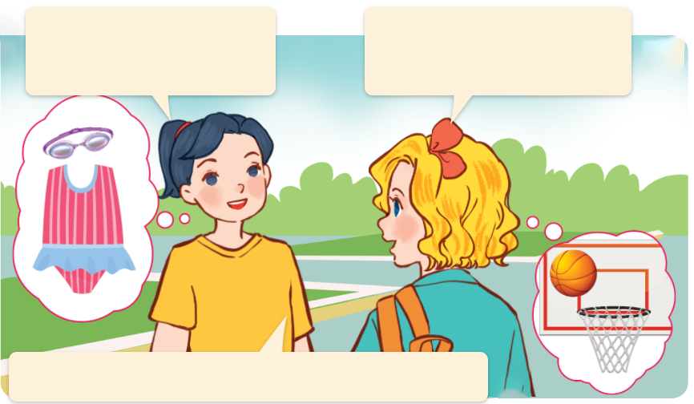
1. Look, listen and repeat.
a
Where are you going, Mary?
b
What’s your favourite sport?
It’s basketball.
What about you?
I’m going to the sports centre.
My favourite sport is swimming.
They’re talking about their hobbies.
Who are they?
They are Mary and Mai.
What are they talking about?
Nhấn vào loa để chạy chữ và nghe toàn bài. Nhấn vào từng câu để nghe lại, muốn nghe lại bao nhiêu lần thì ấn vào câu đó bấy nhiêu lần.
Nhấn vào loa để chạy chữ và nghe toàn bài. Nhấn vào từng câu để nghe lại, muốn nghe lại bao nhiêu lần thì ấn vào câu đó bấy nhiêu lần.

Slide 7
Vocabulary

Slide 8
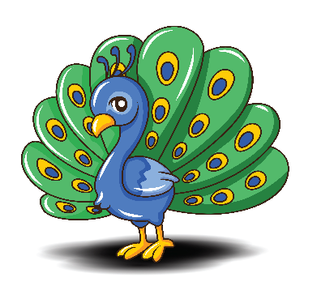
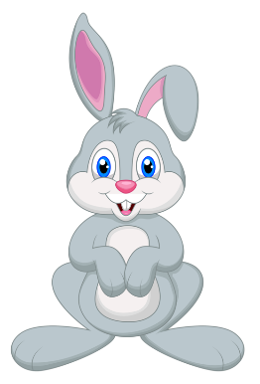
favourite
/ˈfeɪ.vər.ɪt/
ưa thích nhất
Click on the English words to listen.

Slide 9
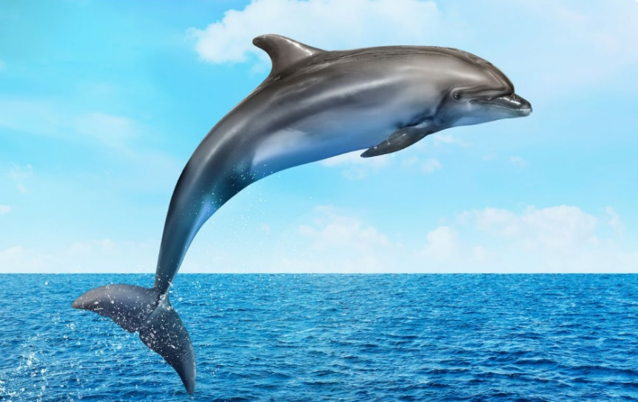
Vocabulary
dolphin
/ˈdɒl.fɪn/
cá heo

Slide 10
pink
/pɪŋk/
màu hồng

Slide 11
table tennis
/ˈteɪbəl tenɪs/
bóng bàn

Slide 12
sandwich
/ˈsæn.wɪtʃ/
bánh mì kẹp

Slide 13
Review
dolphin
favourite
pink
table tennis
sandwich
Click on the English word to listen again.

Slide 14
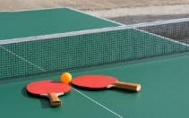
Vocabulary
1. favourite
: ưa thích nhất
2. dolphin
: cá heo
3. pink
: màu hồng
4. table tennis
: bóng bàn
5. sandwich
: bánh mì kẹp
Click on the English word to listen again.

Slide 15
Checking vocabulary
Look and match.
1
2
3
4
5
a
b
c
d
e
favourite
dolphin
table tennis
pink
sandwich

Slide 16
Structures

Slide 17
Cách hỏi ai đó yêu thích cái gì:
What’s your favourite ______?
( _____ yêu thích của bạn là gì ?)
It’s ______.
( Nó là _______.)
Example:
What’s your favourite animal?
It’s a dolphin.

Slide 18
Unit 1 lesson 2
What’s your favourite _____?
It’s _______.
sport / table tennis
food / a sandwich
colour / pink
animal / a dolphin

Slide 19
2. Listen, point and say.
a
b
What’s your favourite _____?
sport / table tennis
colour / pink
c
d
It’s _____.
animal / a dolphin
food / a sandwich
Click on the pictures to listen.

Slide 20
2. Listen, point and say.
a
sport / table tennis
What’s your favourite sport?
It’s table tennis.
Click on the sentences to listen.

Slide 21
2. Listen, point and say.
b
colour / pink
What’s your favourite colour?
It’s pink.

Slide 22
2. Listen, point and say.
c
animal / a dolphin
What’s your favourite animal?
It’s a dolphin.

Slide 23
2. Listen, point and say.
d
food / a sandwich
What’s your favourite food?
It’s a sandwich.

Slide 24
3. Let’s talk.
Can you tell me about yourself?
__________.
What’s your favourite ____?
_________.

Slide 25
3. Let’s talk.
Can you tell me about yourself?
_____________.
I’m in Class 5A
What’s your favourite _____?
sport
It’s table tennis
_____________.

Slide 26
3. Let’s talk.
Can you tell me about yourself?
What’s your favourite _____?
food
I’m in Grade 5
_____________.
_____________.
It’s a sandwich

Slide 27
3. Let’s talk.
Can you tell me about yourself?
_____________.
I’m in Grade 5
What’s your favourite _____?
colour
It’s pink
_______.

Slide 28
3. Let’s talk.
Can you tell me about yourself?
_____________.
I’m in Class 5B
animal
What’s your favourite ______?
It’s a dolphin
___________.

Slide 29
Let’s play!

Slide 30
1/10
sandwich
colour
dolphin

Slide 31
2/10
pink
table tennis
animal

Slide 32
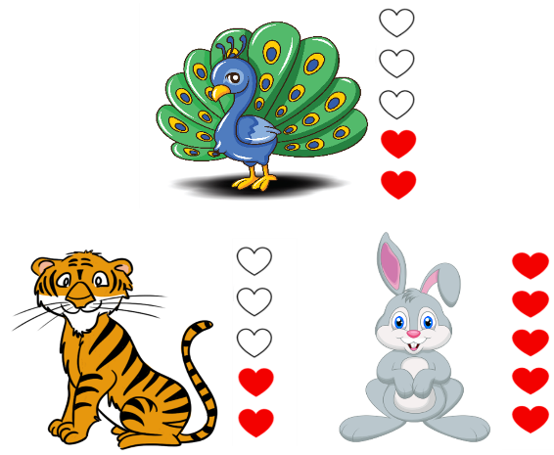
3/10
sandwich
colour
favourite

Slide 33
4/10
blue
green
pink

Slide 34
5/10
giraffe
dolphin
peacock

Slide 35
6/10
A: What’s your favourite ______?
B: It’s a hippo.
sport
animal
food

Slide 36
7/10
A: What’s your favourite ______?
B: It’s football.
sport
colour
food

Slide 37
8/10
A: What’s your favourite _______?
B: It’s white.
sport
food
colour

Slide 38
9/10
True
False

Slide 39
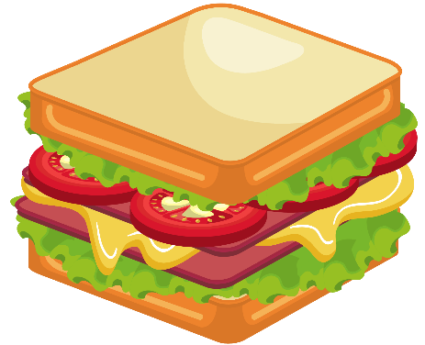
10/10
True
False

Slide 40
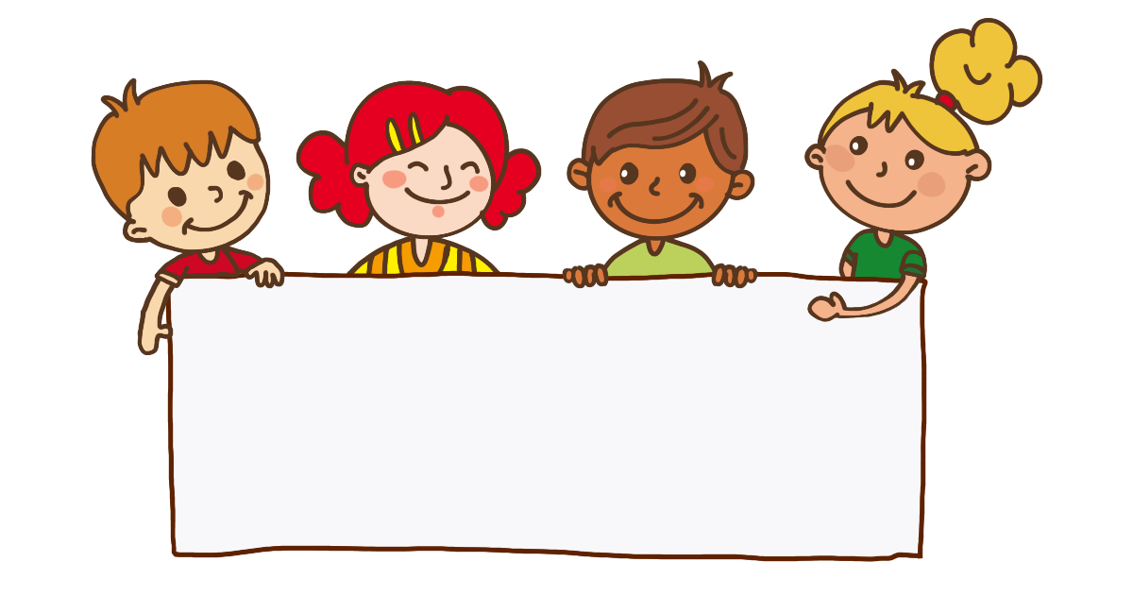
Good job!

Slide 41
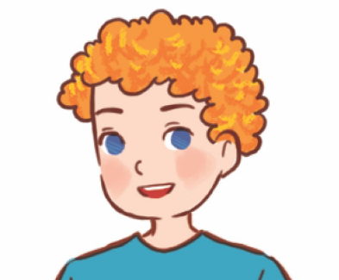
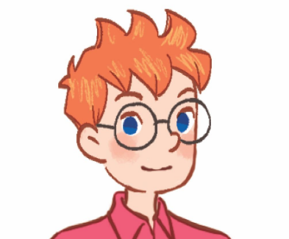
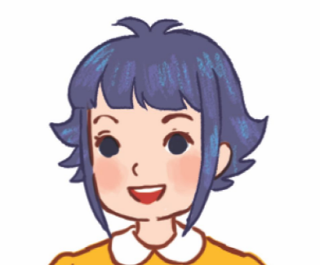
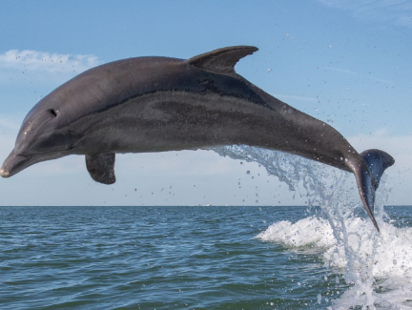
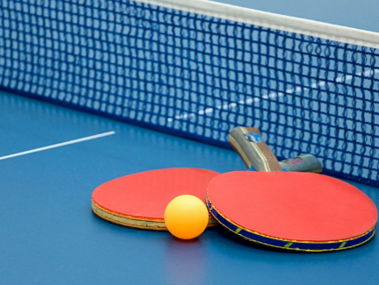
4. Listen and match.
1.
2.
3.
a
b
c
Click on the speaker / leaves to listen.

Slide 42
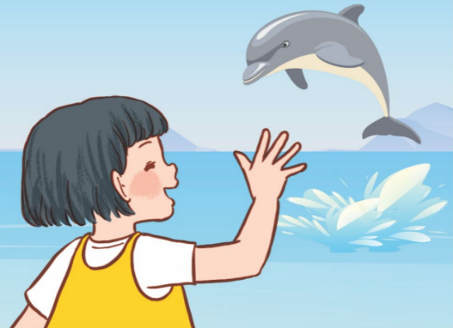
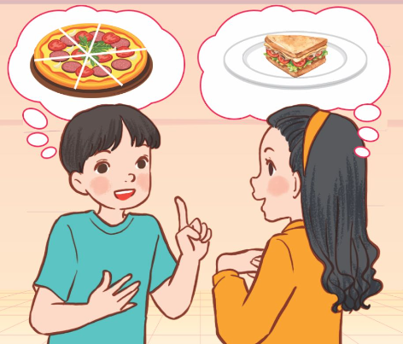
5. Read and complete.
1.
A: Where were you yesterday?
B: I was at the zoo.
A: What’s your favourite animal?
B: It’s _________.
A: ________ do you like it?
B: Because it jumps and dances beautifully.
a dolphin
Why
A: My favourite food is ________.
Do you like pizza, too?
B: No, I _________.
A: What’s your favourite food?
B: It’s ______________.
A: A sandwich?
B: Yes. I love sandwiches.
2.
pizza
don’t
a sandwich

Slide 43
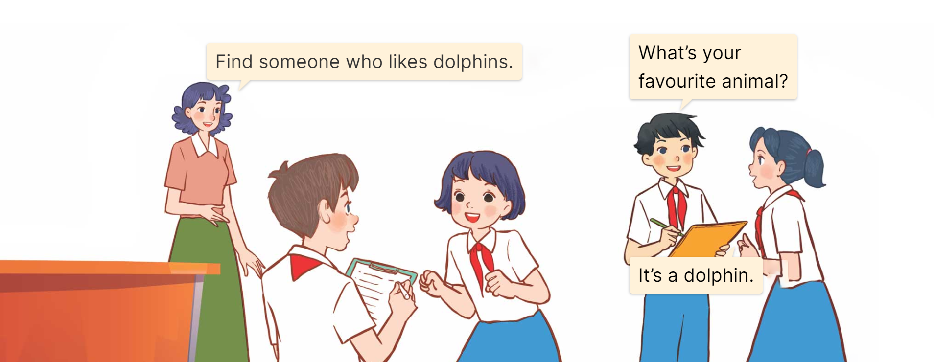
6. Let’s play.
Find someone who …

Slide 44
Fun corner
& wrap-up

Slide 45
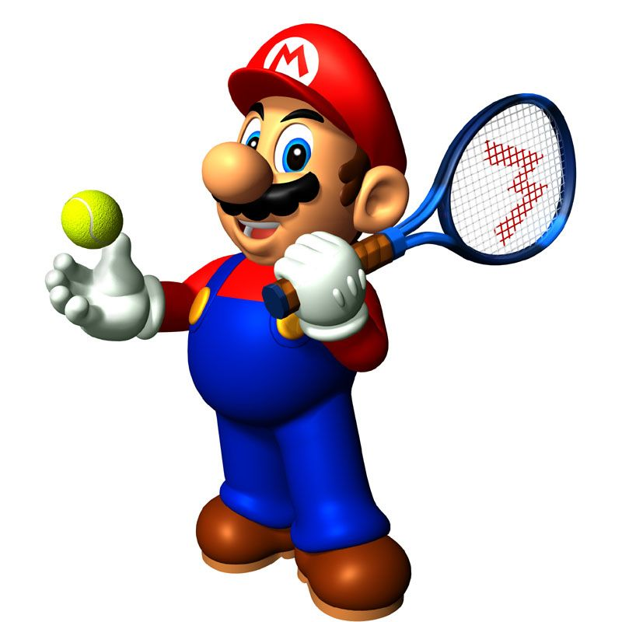

Slide 46
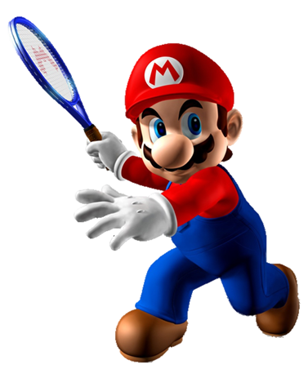
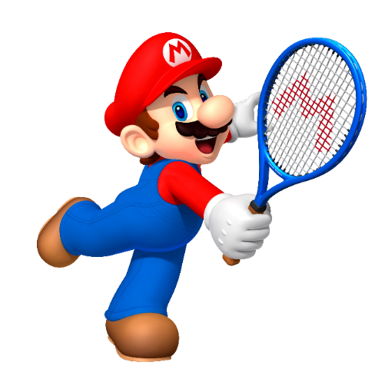
A. It’s a dolphin.
A: What’s your favourite sport?
B: ________
B. It’s table tennis.
C. It’s a sandwich.

Slide 47
A. It’s a sandwich.
A: What’s your favourite food?
B: ________
B. It’s pink.
C. It’s a dolphin.

Slide 48
A. It’s a dolphin.
A: What’s your favourite animal?
B: ________
B. It’s a sandwich.
C. It’s table tennis.

Slide 49
A. It’s black.
A: What’s your favourite colour?
B: _______________
B. It’s white.
C. It’s pink.

Slide 50
A. favourite
A: What’s your ______ sport?
B: It’s basketball.
B. pink
C. yellow

Slide 51
A. 1
B. 2
1. dolphin - sandwich - pink - table tennis
C. 3
2. dolphin - sandwich - blue - tennis
3. dolphin - sandwich - black - badminton

Slide 52
A. Can you tell me about yourself?
B. What’s your favourite animal?
A: ________________
B: It’s a dolphin.
C. What’s your favourite food?

Slide 53
A. What’s your favourite sport?
A: ________________
B: It’s pink.
B. What’s your favourite food?
C. What’s your favourite colour?

Slide 54
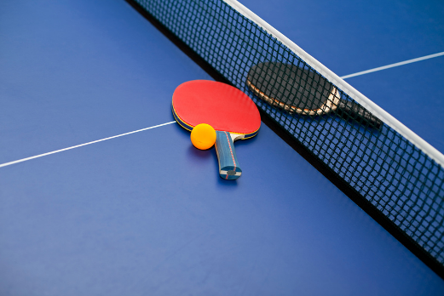
A. True
B. False

Slide 55
A. True
B. False

Slide 56
Good job!

Slide 57
Unit 1 lesson 2
What’s your favourite _____?
It’s _______.
sport / table tennis
food / a sandwich
colour / pink
animal / a dolphin

Slide 58
Homework
Learn by heart all the new words and the model sentences.
Read again the dialogue in part 1. Prepare for the lesson …..

Slide 59
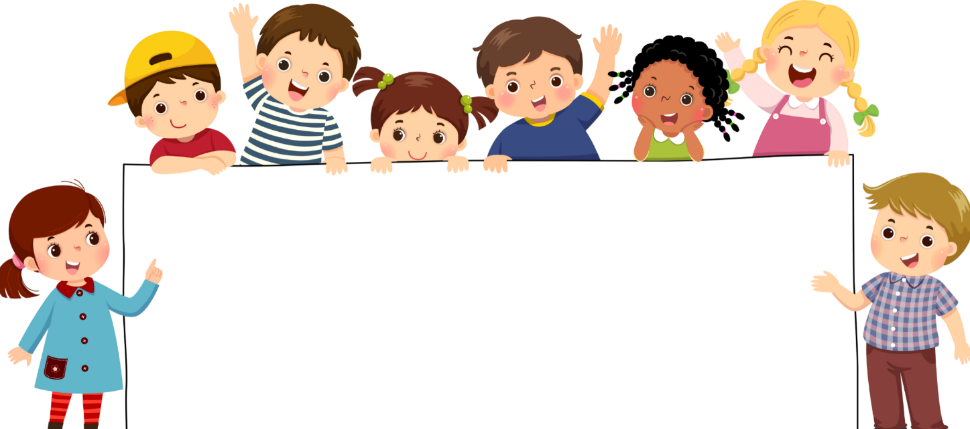
Goodbye!
Bùi Liễu Powerpoint
0968142780

